Slide 2
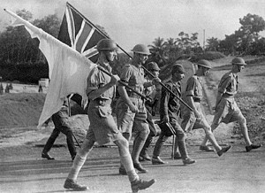
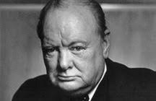
Churchill and the Fall of Singapore
“No failure of anyone in Malaya at the time, combatant or non-combatant, contributed to the disaster, which was the inevitable consequence of the policy of His majesty’s Government.”
C.A. Vlieland, Malayan Secretary for Defense.

Slide 3
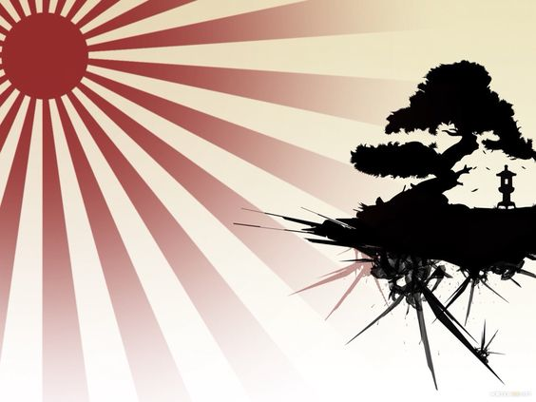
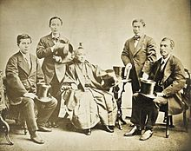
Japan’s Rapid Economic and Military Development
Japan went through a long period of voluntary isolation. In other Asian countries there was a clear pattern in which freedom was lost and they became colonies of European powers. First came explorers, then missionaries, traders and finally the military which effectively took over opening the country to the rule of foreign powers. During the Meiji Period in Japan from 1868 to 1912 the government sent groups of scholars, military officers, medical experts, industrialists and teachers to a range of countries in order to catch up with the latest industrial and military technologies and educational techniques. One such group was called the Iwakura Mission shown below. Based on the information gained from these trips Japan was able to make rapid progress as an industrial and military power.
England Steel making, shipbuilding, engineering
United States Education
Germany Military, medicine

Slide 4
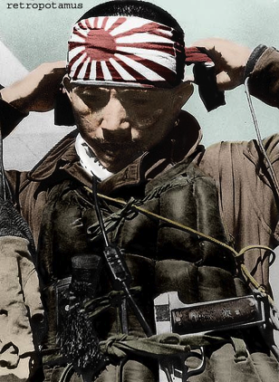
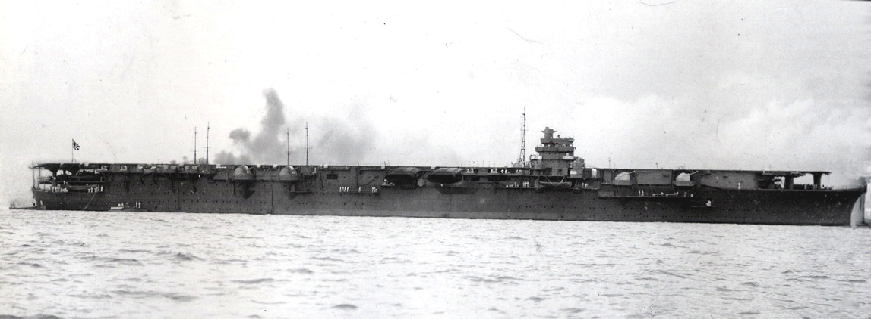
Reasons for declining relations between England and Japan
Before and during the First World War Britain and Japan had been allies but later looked upon each other as potential enemies, especially in South East Asia.
Japan had begun to develop strong feelings of Anglophobia and they were angry about being given inferior status to the European powers and America in the Washington Treaty. 5:5:3.
The Japanese were setting up their own empire by invading parts of Korea and China.
The Japanese navy had battleships and aircraft carriers superior to the aged British fleet.
Japanese aircraft carrier “Shokaku” completion August 1941

Slide 5
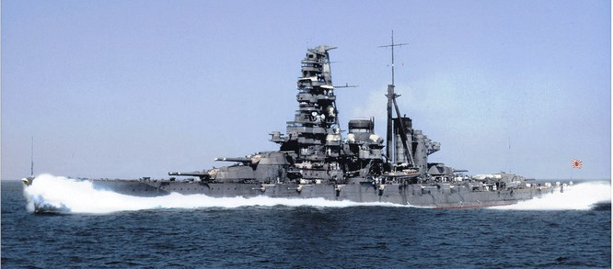
Without a huge building program there was no way the British Navy could match developing Japanese and American naval power.
Japanese battleship “Haruna” which
took part in both the first and second world wars.

Slide 6
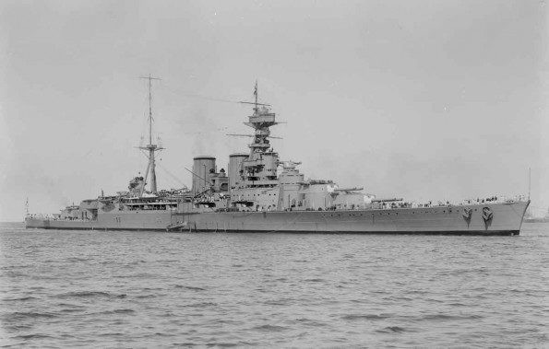
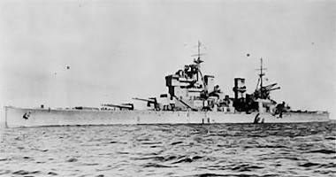
Britain’s post World War One problems with regards to maintaining naval power.
Britain needed one fleet in European waters and one in the Far East. She could not afford to build a new base in the east and a new fleet to go with it as her ships were aging and not the quality of those being built by Germany and Japan. In 1921 it was decided to build the new base in Singapore rather than Sydney. Australia was promised that in the event of hostilities a fleet from Britain would arrive within 70 days. This was referred to as “The Myth of the Fleet” because in such a situation the British would have their hands full with just the Germans. A clear credibility gap existed between British promises and what they actually could deliver. The time necessary to reach Australia grew from 70 days to 90 days and then 6 months. In reality Britain had no ships for service anywhere while the danger from Germany existed.
HMS Hood HMS Prince of Wales

Slide 7
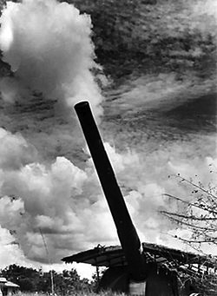
New Plans for the Defense of Singapore
Due to the problems involved with sending naval assistance south, the defense of Malaya and Singapore fell to the army and the RAF. They would have to be able to sustain an indefinite siege.
The navy decided against building the new base on the seaward side as it would be too close to the commercial harbor. It was then decided that Singapore would be protected from the sea and not the land. It was believed that the jungle off Johore and South-east Malaya would guard against any landward attack and one from the north would take an enemy too long.
These decisions angered the army as they had not been
consulted and a forward deployment of troops would be
necessary to guard them. The army wanted heavy artillery.
The RAF backed Torpedo bombers and fighters due to their
longer range. The army won the argument there being no
proof that planes could sink warships and any such planes
would be needed to defend the home islands. Artillery
won the day. Airfields were, however, set up in the north and
east
Naval defense guns at Singapore being tested December
1941.

Slide 8
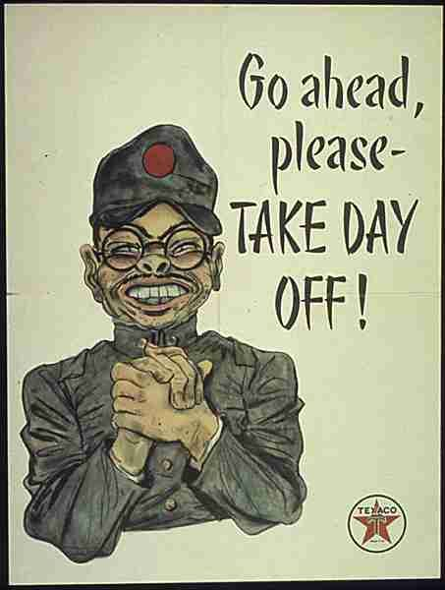
A staff assessment carried out by high-ranking officers asserted that the Japanese would capture airfields in Southern Thailand, land in Northern Malaya and Southern Thailand and then advance down the Malayan Peninsular to Singapore. They concluded that the jungle would not be an obstacle and that Singapore was vulnerable to a land attack from the north. This is exactly what happened. Brigadier A.E. Percival was one of these officers.
The reaction from the war office was as follows:
The British Fleet would sail whatever the the situation elsewhere.
The Japanese were heavily involved in China
Tanks were not considered necessary
There was little money available for rearmament
Actual situation:
A fleet would not be sent to Singapore if the homeland was in
danger itself. In addition the British fleet was old and no match
for the more modern Japanese navy. Churchill was well aware of
this
Ship Comparison
Completion Displacement Armament Speed Armour
King George V 11/1941 38,000 tons ten 14 inch 29 knots 16 inch
Yamato 12/1941 64,170 tons nine 18 inch 27 knots 20 inch

Slide 9
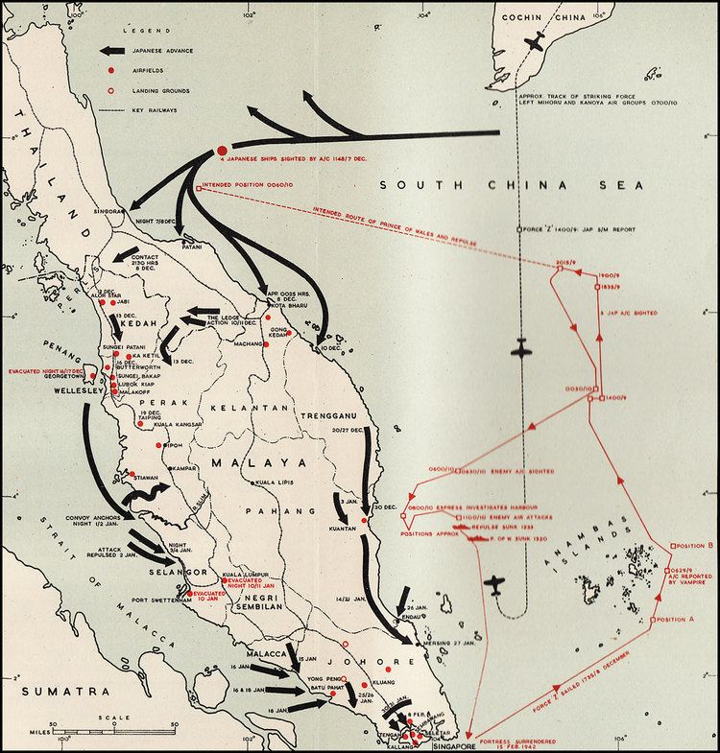
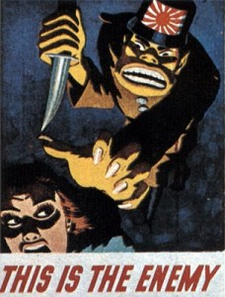
Japanese Invasion of Malaya
On 6 December 1941 the Japanese landed unopposed at Singora and Patani in Cambodia. British resistance began when they moved into
Malaya. Japanese planes were far superior to those of the RAF and the loss of the Prince of Wales and Repulse was devastating to British moral. Despite outnumbering the enemy 3 to 1 their minds turned to evacuation but this would be very difficult as the enemy controlled both land and sea. They had seriously underestimated their enemy. The Japanese Zero cleared the skies of allied aircraft and really brought home the truth to the British.

Slide 10
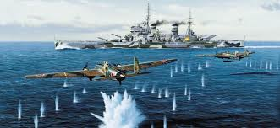
The Prince of Wales and the Repulse
As a result of sending a large number of aircraft to Russia and the ill-fated Greek campaign, 600 first-rate planes were not available for use in Singapore and the only way it could be reinforced was by the navy. The navy’s old ships would be hopelessly outclassed by the modern Japanese navy so Churchill decided to send the Prince of Wales, despite her mediocre performance against the Bismark, along with the old battle cruiser Repulse. It was also planned to send the aircraft carrier Indomitable as well but she had ran aground. It was actually a futile gesture. Four hundred miles from Singapore they were attacked and sunk by 88 bombers and torpedo-bombers from Indo-Chinese land bases with the loss of 840 lives. Without air cover the days of the battleship were over.
Without air protection the ships were sitting ducks

Slide 11
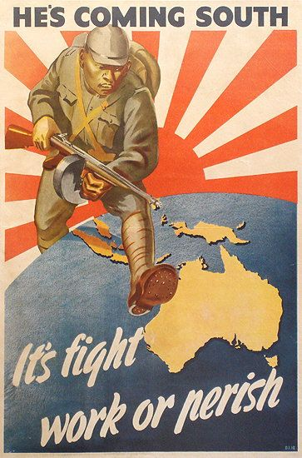
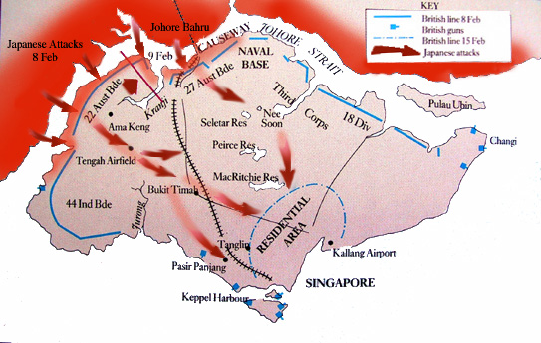
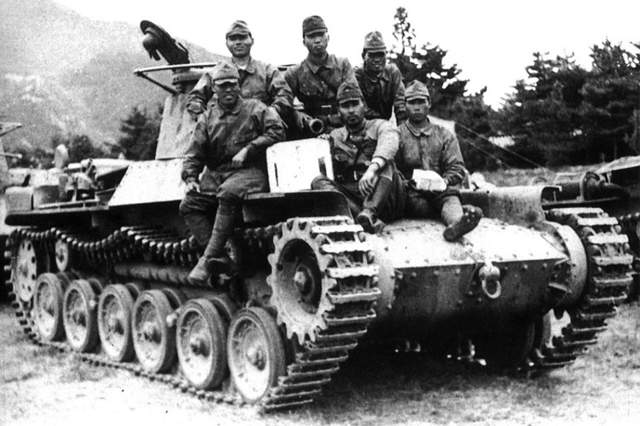
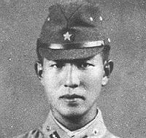
Japanese Invasion of Singapore

Slide 12
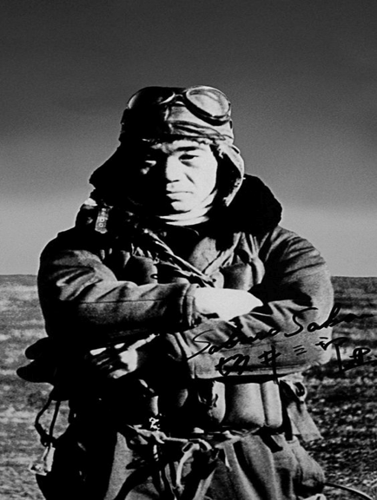
Airpower
The Chiefs of Staff had estimated that the defense of Malaya required 22 squadrons of planes consisting of 336 aircraft. They believed they would be capable of sinking 70% of an attacking naval force. The RAF put the number at around 556. The Japanese had around 700 aircraft at their disposal.
On the ground at that time the British had 141 second rate aircraft consisting of 17 Hudsons, 34 Blenheim bombers, 27 Wilderbeeste torpedo bombers, 10 Blenheim night-fighters, 3 Catalina flying boats, 4 Swordfish, 5 Sharks and 41 Brewster Buffalos. A total of just 158 very low quality aircraft. All of the above were hopelessly outclassed by the Japanese Zeros.
One reason for the lack of up-to-date fighters was that
Churchill had sent 200 Hurricane fighters to Russia to
help his new Allies in Russia withstand the German
invasion. Many aircraft were also sent to take part in
the ill-fated Greek campaign.
In Churchill’s own words “I do not remember to have
given my approval to these very large diversions of
Forces. The political situation in the Far East does
not seem to require the maintenance of such large
Forces there at this time”.

Slide 13
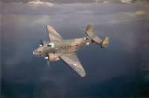
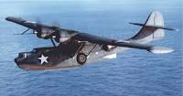
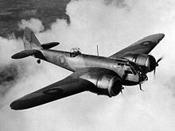
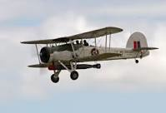
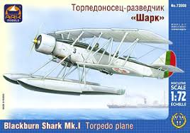
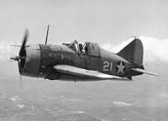
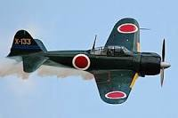
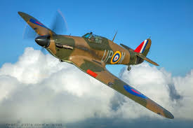
Hudson Catalina Flying Boat Blenheim bomber
Swordfish Blackburn Shark Brewster Buffalo
Mitsubishi Zero 1000 Wildebeeste Torpedo-bomber Hawker Hurricane
Notes:
e

Slide 14
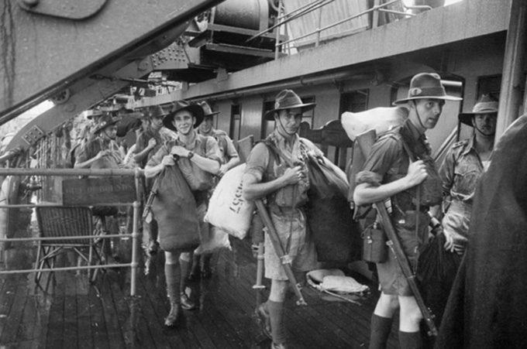
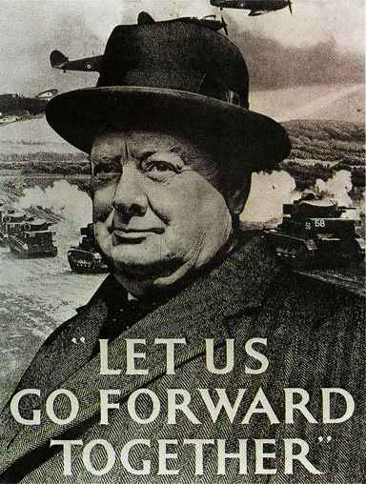
Singapore had been built for a Far Eastern fleet which Britain would now never again be in a position to command. It then became a matter of British pride rather than one of strategic importance. Minds turned to evacuation but this would be very difficult with the enemy controlling the air and the sea. Even though the British outnumbered their enemy three to one moral declined alarmingly. They had seriously underestimated their enemy.
Singapore had become a symbol whose moral value had become greater than its political and strategic significance. Promises made to Australia and New Zealand had become more important than anything else.
Australian troops arriving in Singapore before the Japanese takeover.

Slide 15
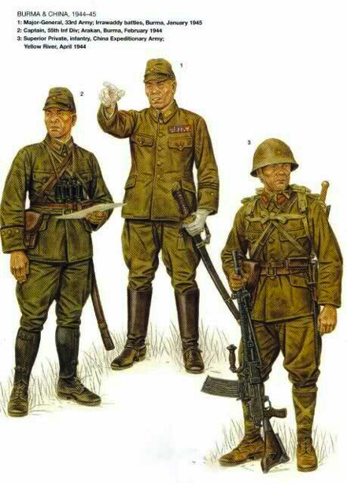
Before the war Churchill spoke of Singapore as a fortress which it was not. Both the British public and their leaders had failed to see the weaknesses of Singapore as a military stronghold. The British public out of ignorance and leaders out of stupidity or dishonesty had failed to recognize these weaknesses. Although there were plenty of troops available they had been tied down in small pockets protecting airfields and other installations.
Troop numbers at start of war in Singapore
Total 90,000
British 20,000
Australian 15,000
Indian 37,000
Local Asian 17,000
Many of the troop in Singapore were poorly trained with
second-rate officers. The best Indian troops and their
officers had been sent to North Africa and the Middle
East. Talented white officers were sent to other theatres
of the war.
Many of the Australians were untrained and some had been sent only two weeks after enlistment and hardly knew how to handle a gun. They found themselves in the field against a well-equipped and professional army whose capabilities had been seriously underestimated.

Slide 16
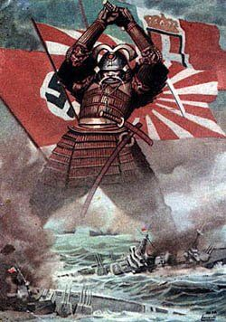
Further Reasons for the failure of British and Empire Troops Against the Japanese
Instead of anti-tank guns London sent manuals on how to combat tanks without guns. These manuals were not issued until Brigadier Ivan Simpson found them and devised a system for opposing tanks but he was forbidden to distribute it.
Britain anticipated almost every aspect of Japan’s strategy but was unable to do anything about them. The British did not expect japan to make a move during the Northern monsoon despite the fact that Japan had done so when invading China.
Japanese use of bicycles when advancing through Malaya surprised the British.
Japanese’s inferior light tanks outnumbered their British
counterparts of which there were only ten. These were the
only armour Churchill ever sent to the Malaya-Singapore theatre.
Japanese jungle tactics outclassed those of their enemy. Much of the British army was engaged defending a
useless naval base and airfields which catered for inferior aircraft.
Troops who could have been of some use earlier suddenly
arrived only in time to increase the number of prisoners
of war.

Slide 17
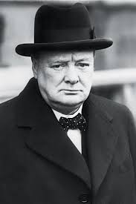
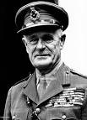
Singapore: The worst disaster and largest capitulation in British history.
Prime Minister Winston Churchill and General Archibald Wavell
The heavy guns of the coastal defenders which could fire northwards were not much use with their limited ammunition against jungle covered country.
Only one squadron of fighter aircraft remained on the island and only one aerodrome was usable.
Thirty miles of front had to be defended but due to jungle nothing could be seen of enemy movements on the other shore. This was an advantage to the attackers.
The majority of fighter aircraft had been withdrawn to Sumatra on orders of General Wavell thus causing a waste of flying time and the inability to intercept from their base. Half of the fighters left on the island were inferior Buffaloes.
Only 70,000 of the 106,000 troops in the garrison were armed.
“The 18th division has a chance to make its name in history. Commanders and senior officers should die with their troops. The honor of the British Empire and the British army are at stake.” Winston S Churchill
“The chief troubles are the lack of sufficient training in some of the reinforcing troops and inferiority complex with bold and skillful Japanese tactics and their commands”
General Archibald Wavell
The information above was taken from “The Second World War. Volume IV “The Hinge of Fate” Winston S. Churchill. Cassell and CO.LTD

Slide 18
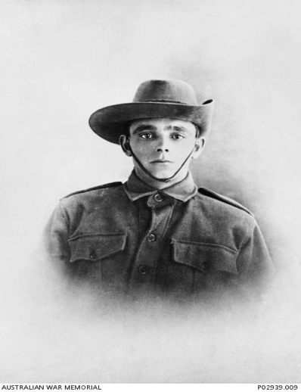
Problems for fresh troop arriving
* They had to be billeted
* They were not well disciplined
* They were trained for mechanized warfare but they were
not going to experience this
* Their arrival at this time was strategic absurdity
* They were leaving their ships to become certain prisoners
of war
Which was more humiliating? To lose Singapore without making an effort or to fight to the last man and still lose it? In January 1942 the British Government was facing certain disaster in Singapore. Sending substantial reinforcements was a most serious mistake. They could have been used to a much greater advantage somewhere else. Churchill resorted to exhortation and demanded the troops fight to the last man leaving nothing but “scorched Earth”. It was inconceivable that a parliamentary democracy would consider fighting a battle of annihilation in a city inhabited by a million subjects that it pledged to protect.
The problem was of Churchill’s own making. He was prepared to squander his forces in pursuit of unrealistic political gains.
The information presented in this presentation to this point has been taken from “Great Military Disasters” By Geoffrey Regan copyright 1987. M. Evans & Company, Inc. New York.

Slide 19
“In the final analysis the fall of Singapore was part of the price the British Empire paid for Churchill’s big idea. He had chosen the Middle East, North Africa and Greece as places where fighting offered the best prospects of bringing the United States into the war against Hitler. He gambled that Japan would not come into the war, and stripped the Far East of both the means and purpose of imperial defense. Serious reinforcement of the Far East would have cut across his idea and might have undermined it. Hence his rows with his Chiefs of Staff in 1941, and his dismissive attitude towards Australian anxieties”
Australian war historian, Dr Robert O’Neil wrote:
“it is scarcely to Australia’s credit that it had preferred to take British reassurances at face value and do so little of its own volition to exploit the defensive worth of the long approaches to its own shores. Australian recrimination over the British Government’s tardiness in recognizing the seriousness of the Japanese threat would have carried greater weight had the Australian governments placed a little more faith in the warnings of their military advisers.” “In the 10 weeks of the Malayan Campaign, the AIF, 14% of British combat strength, had suffered 78% of the deaths in battle and 15,000 Australians were taken prisoner”
Upon hearing of the Japanese Attack on Pearl Harbour Churchill wrote “We had won the war. England would live; Britain would live the Commonwealth of Nations and the Empire would live.” He then went to bed and slept “the sleep of the saved and the thankful” To Churchill at this time getting the Americans into the war was of the upmost importance.
“Churchill and Australia” Graham Freudenberg 2008. First published in Macmillan by Pan Macmillan Australia Pty Limited 1 Market Street, Sydney

Slide 20
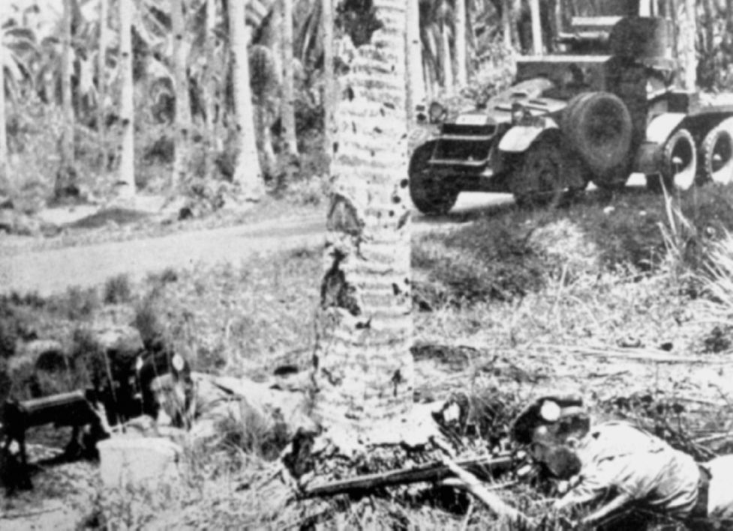
British troops in Malaya with rifles, machine gun and armored car

Slide 21
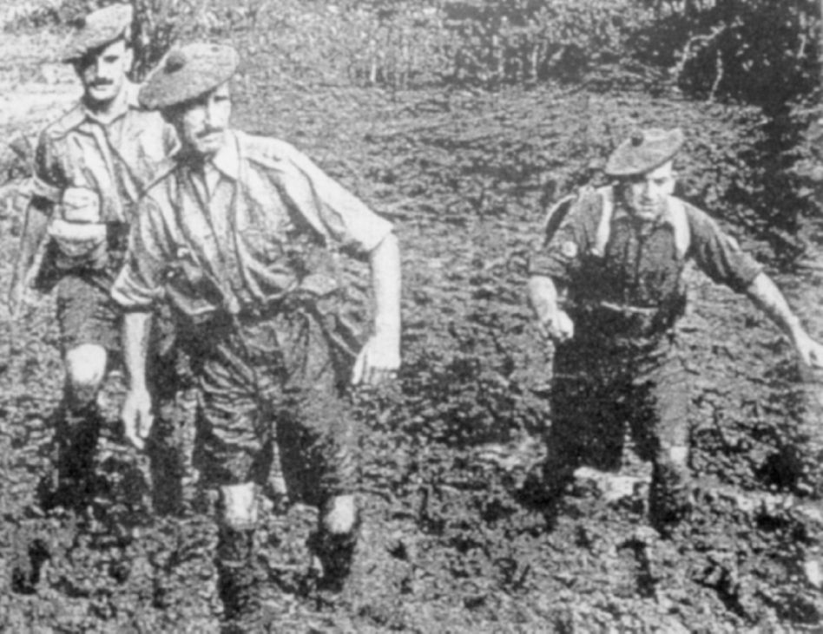
Slogging through the mud

Slide 22
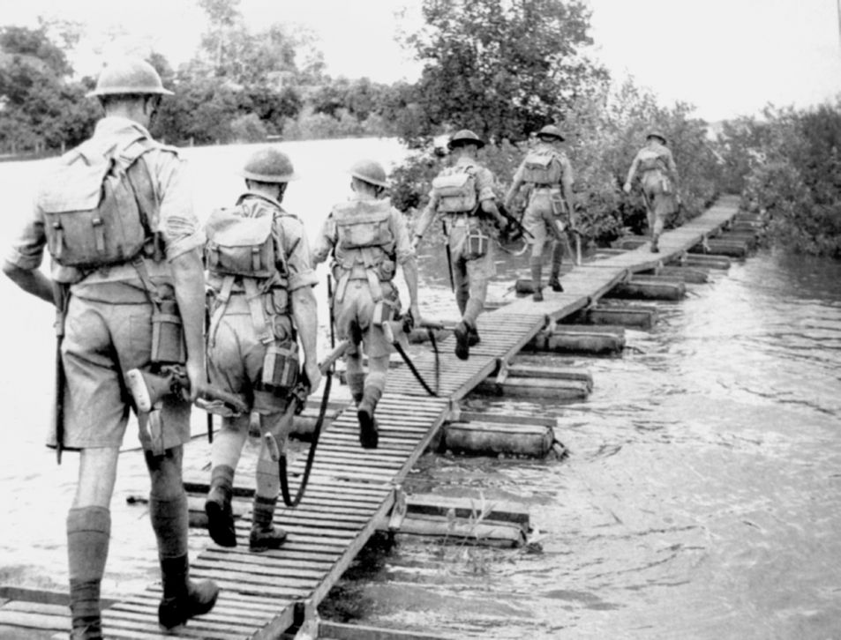
Crossing a river

Slide 23
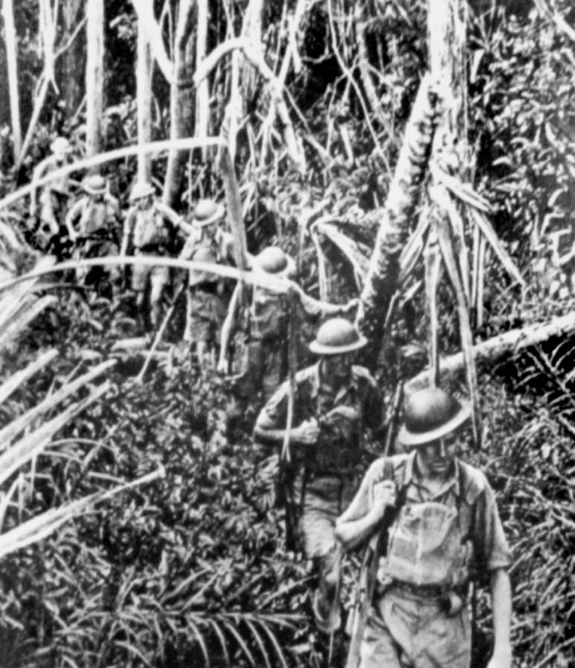
Thick almost impenatrible jungle

Slide 24
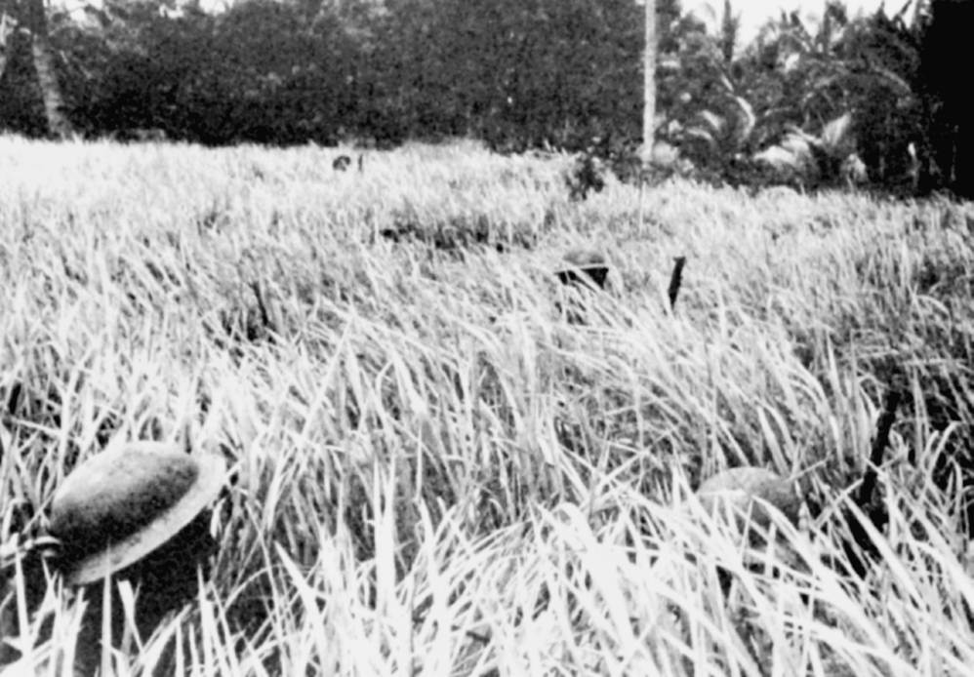
Where the hell are we?

Slide 25
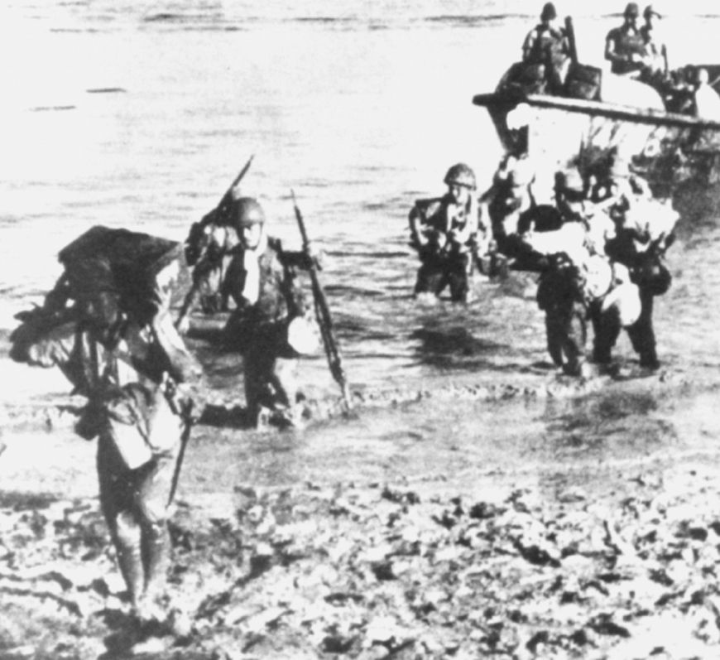
Japanese troops landing on a river bank

Slide 26
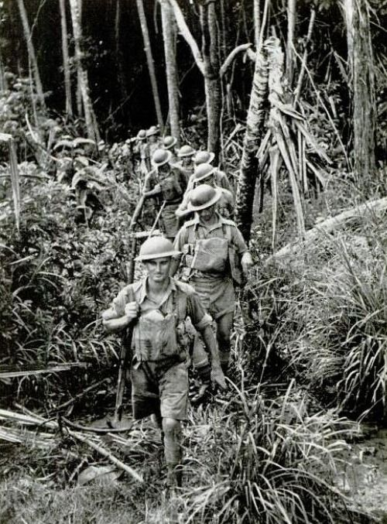
Allied troops moving though the jungle

Slide 27
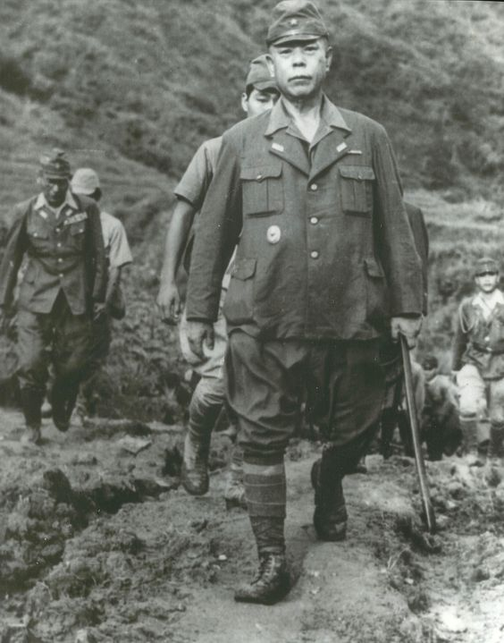
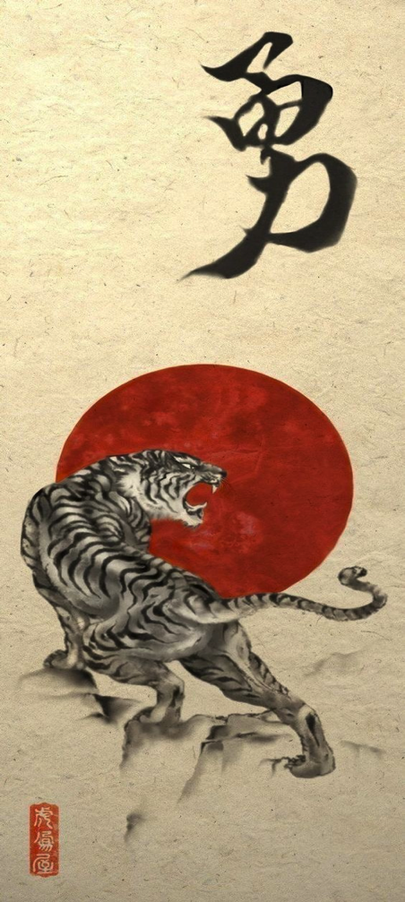
Tomoyuki Yamashita: the Tiger of Malaya

Slide 28
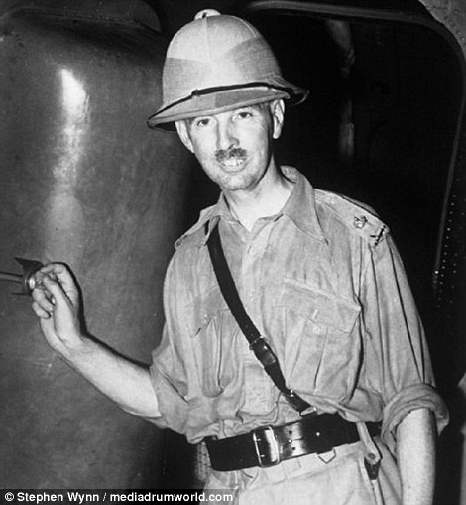
General Arthur Percival. A scapegoat?

Slide 29
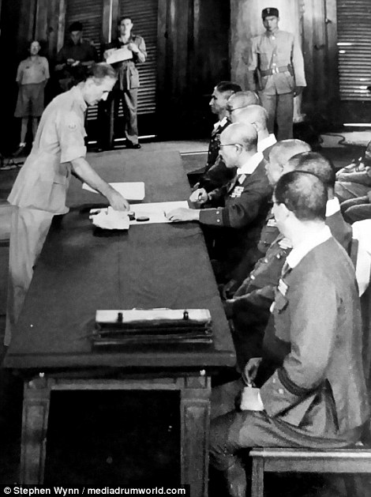
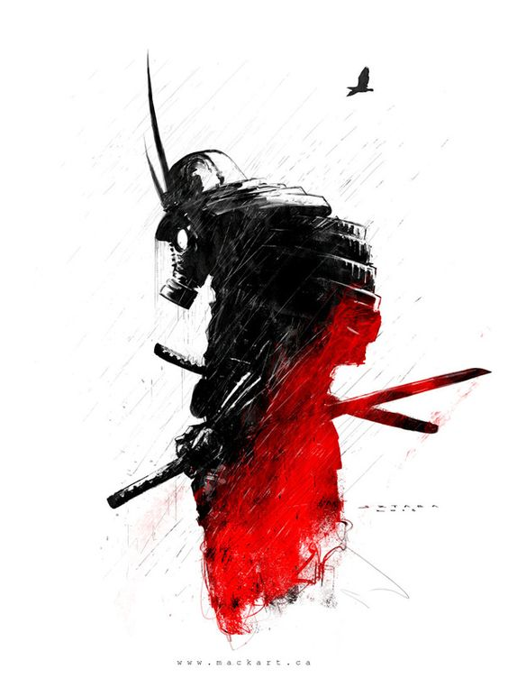
February 15th 1942
Singing the surrender of Singapore

Slide 30
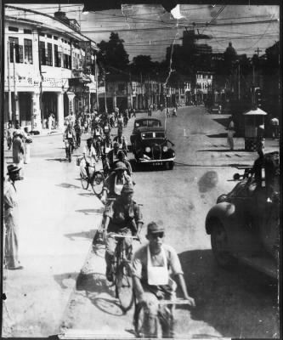
Japanese troops riding their bicycles into Singapore

Slide 31
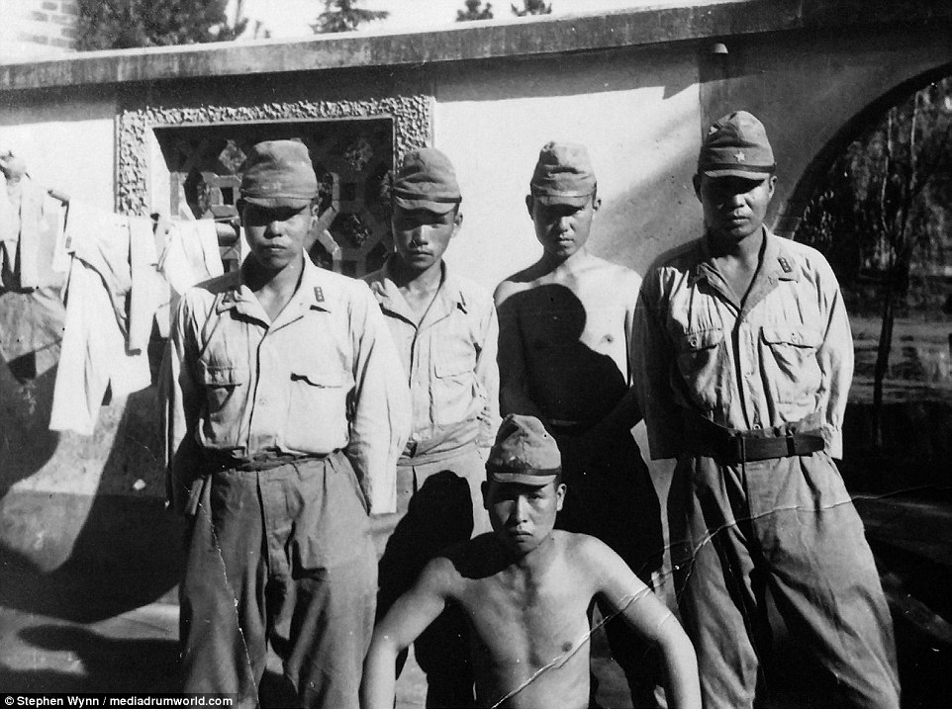
The Victors?

Slide 32
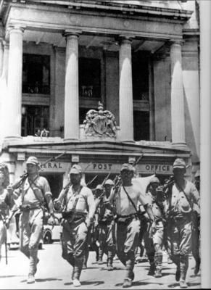
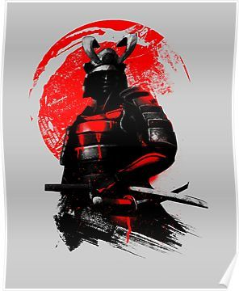

Slide 33
Free at last!

