Slide 1
Battle of Sudoměř,
25 March 1420

Slide 2
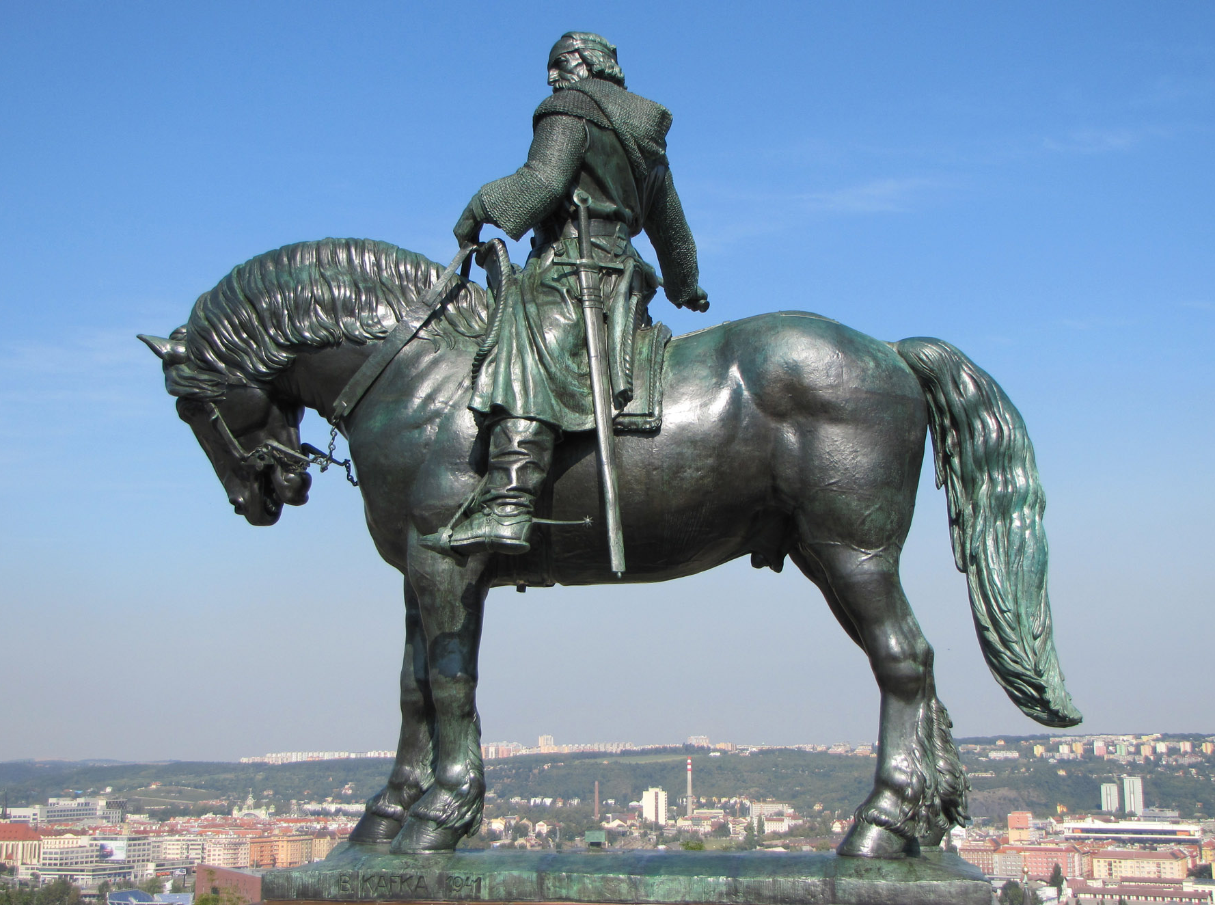
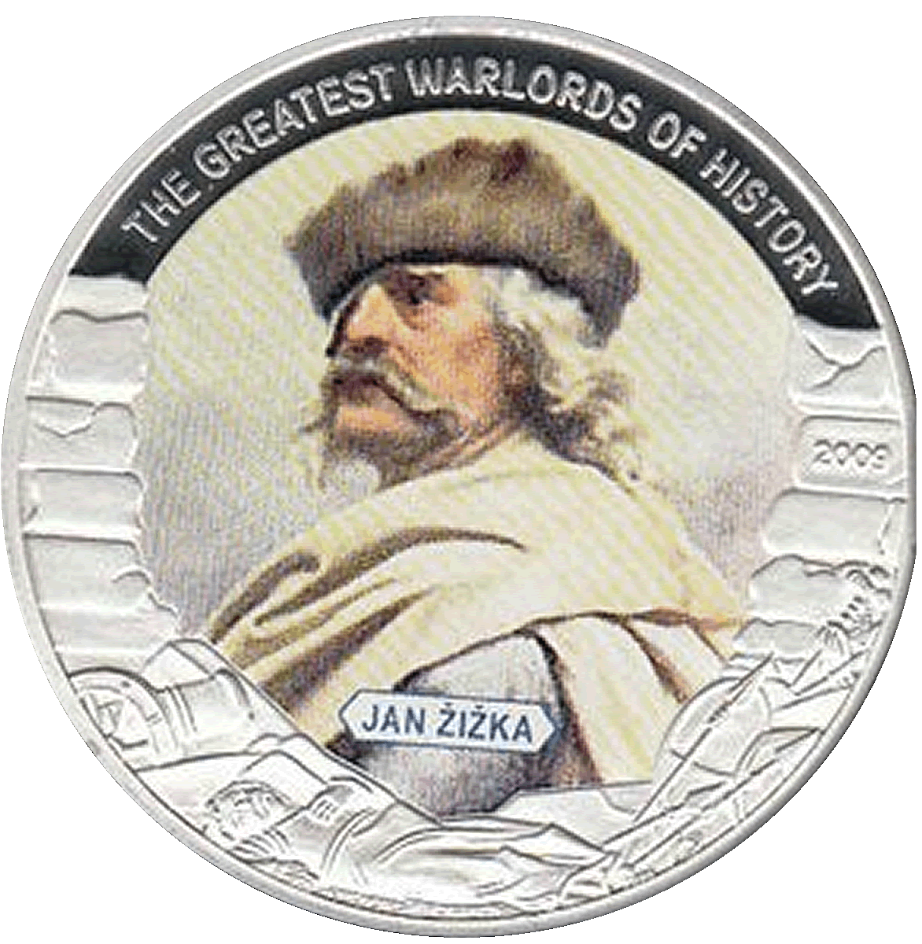
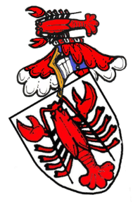
Notes:
the third largest bronze [[equestrian statue]] in the world

Slide 3
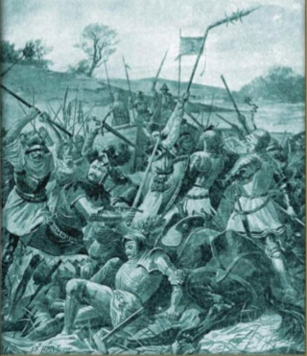
Battle of Sudoměř 25 March 1420
2,000 of the best cavalry in the world fought 400 Infantry...

Slide 4
Battle of Sudoměř 25 March 1420
2,000 of the best cavalry in the world fought 400 Infantry...
and lost!

Slide 5
Battle of Sudoměř 25 March 1420
2,000 of the best cavalry in the world fought 400 Infantry...
and lost!
twice!

Slide 6
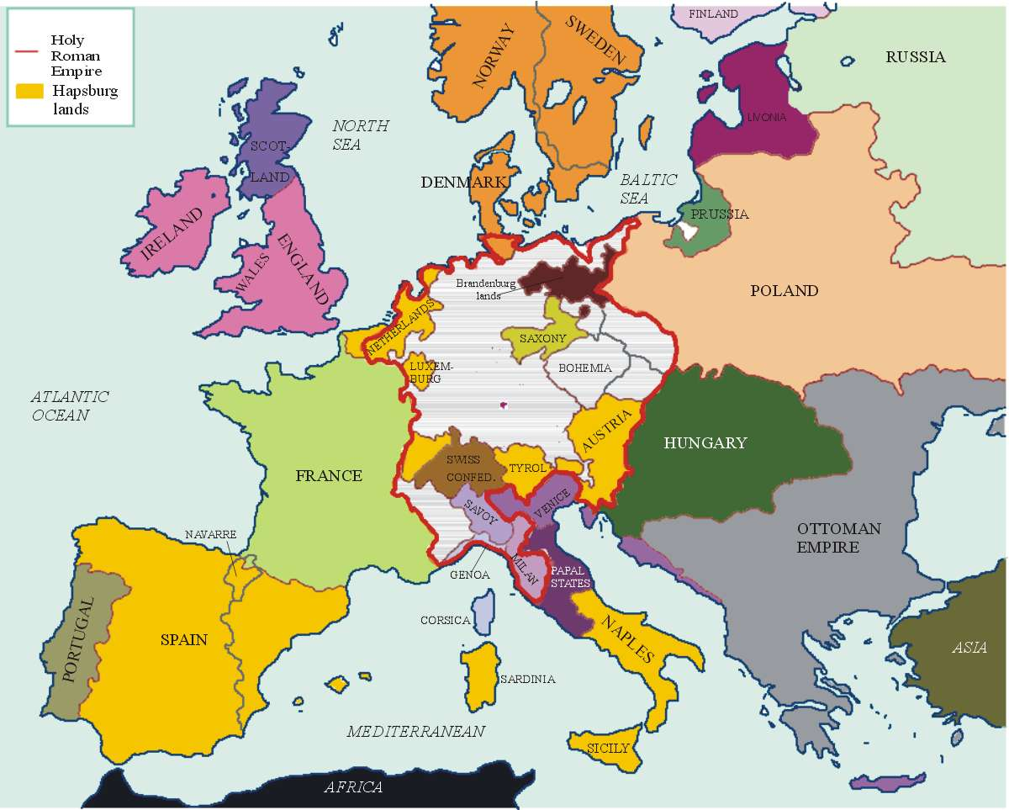

Slide 7
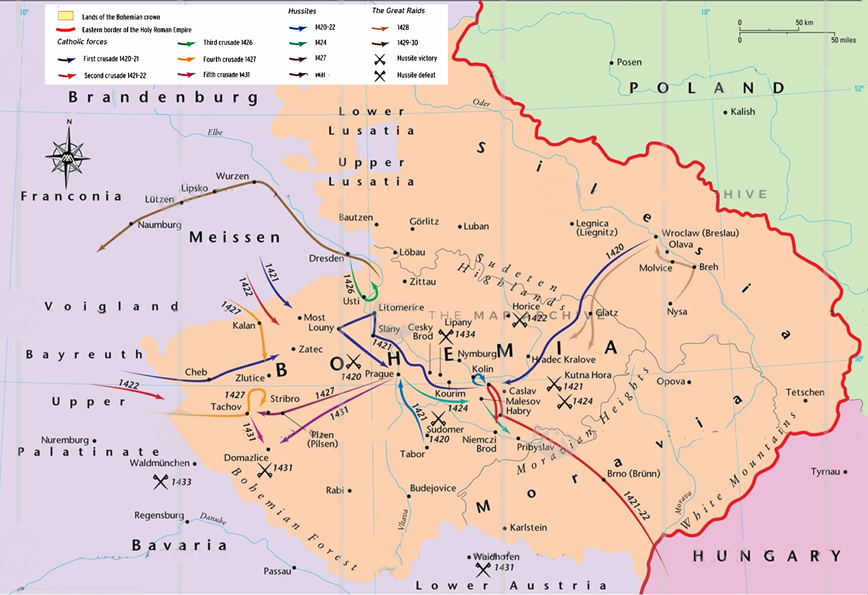

Slide 9
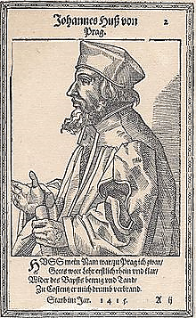

Slide 10
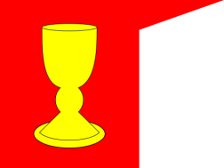
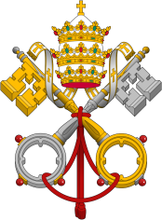
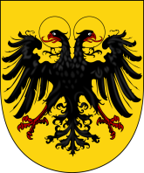
Jan Hus, Reforming Priest
Jan Hus was a Bohemian (Czech) priest and a teacher and rector at the University of Prague. Like Bohemian king and queen Wenceslaus and Sofia, Hus sympathised with reformers like John Wycliffe, who smuggled English-language Bibles into England.
The Roman Church was in the throes of the Papal Schism from 1378-1417, where three men, each driven by politics, claimed to be the true pope.
France and England were midway through the 100 Years’ War, with the numerically superior French chasing Henry V’s depleted and exhausted army to drive them from France. The armies were so meet at Agincourt on 25 October 1415, where the French army would be annihilated.
In about 1402, Priest Jan Hus tacked a tract called “Six errors” to the door of his church that denounced corruption of the Catholic Church. In 1411 Hus denounced indulgences to fund pope John XXIII’s crusade against pope Gregory XII. Widely popular at home, Jan Hus’ continuing calls for reform of Rome’s corruption angered the Church hierarchy.
Notes:
Reforms included bibles in the “vulgar” languages for all to read and communion in both kinds, bread and wine. The major error pointed out was the pope as God’s representative on earth. Later wrote the church was founded on Christ, not on Peter. Excommunicated in 1412.

Slide 12
The Murder of Jan Hus
Three of Hus’s followers were beheaded in 1412. Attempts by Wenceslaus IV to reconcile the parties failed.
Hus continued to preach and to call for reforms. On 18 October 1412, he bypassed secular and clerical authority to appeal to Jesus Christ as the supreme judge. Leaving Prague, Hus published De Ecclesia and various tracts in 1413, which were condemned with Wycliffe’s writings by Rome.
In late 1414, Wenceslaus’s brother king Sigismund of Hungary convened the Council of Constance to end the papal schism and address other religious issues. Hus was invited to the Council under a safe conduct; he made a will before setting out.
Initially the safe conduct was observed, but Hus was arrested about 4 weeks later and imprisoned on 4 December 1414. Sigismund was furious, but…
Notes:
Reforms included bibles in the “vulgar” languages for all to read and communion in both kinds, bread and wine. The major error pointed out was the pope as God’s representative on earth. Later wrote the church was founded on Christ, not on Peter. Excommunicated in 1412.

Slide 13
Anyone who disagrees with the Church is a heretic.
Per the Roman Catholic church
Oaths made to heretics are not binding.

Slide 14
After six months in prison, Hus was tried on 5 June 1415 for the first time. He agreed to recant if shown errors from the Bible.
A total eclipse of the sun occurred at 7:06 am on 7 June 1415.
His final trial took place the following day on 8 June 1415.

Slide 15
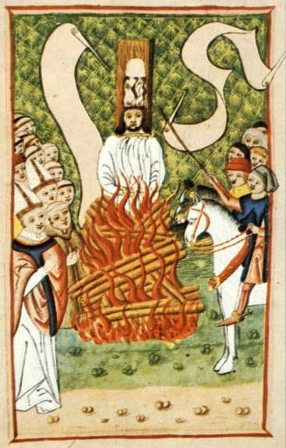
The Murder of Jan Hus
On 6 July 1415, Jan Hus was brought from his prison to the Council chambers. The public was silenced under punishment of excommunication, fines and imprisonment.
The sentence was read out and Jan Hus was condemned to be publicly humiliated and executed. From his knees, Hus asked God to forgive his enemies. After being defrocked, Hus was handed over to the secular authorities for execution.
When he arrived at the place of execution, witnesses claim that he appeared joyful, singing hymns and praying. He even exchanged witty repartee with his executioner.
He then continued singing and praying until stopped by the flames.
Notes:
Reforms included bibles in the “vulgar” languages for all to read and communion in both kinds, bread and wine. The major error pointed out was the pope as God’s representative on earth. Later wrote the church was founded on Christ, not on Peter. Excommunicated in 1412.

Slide 16
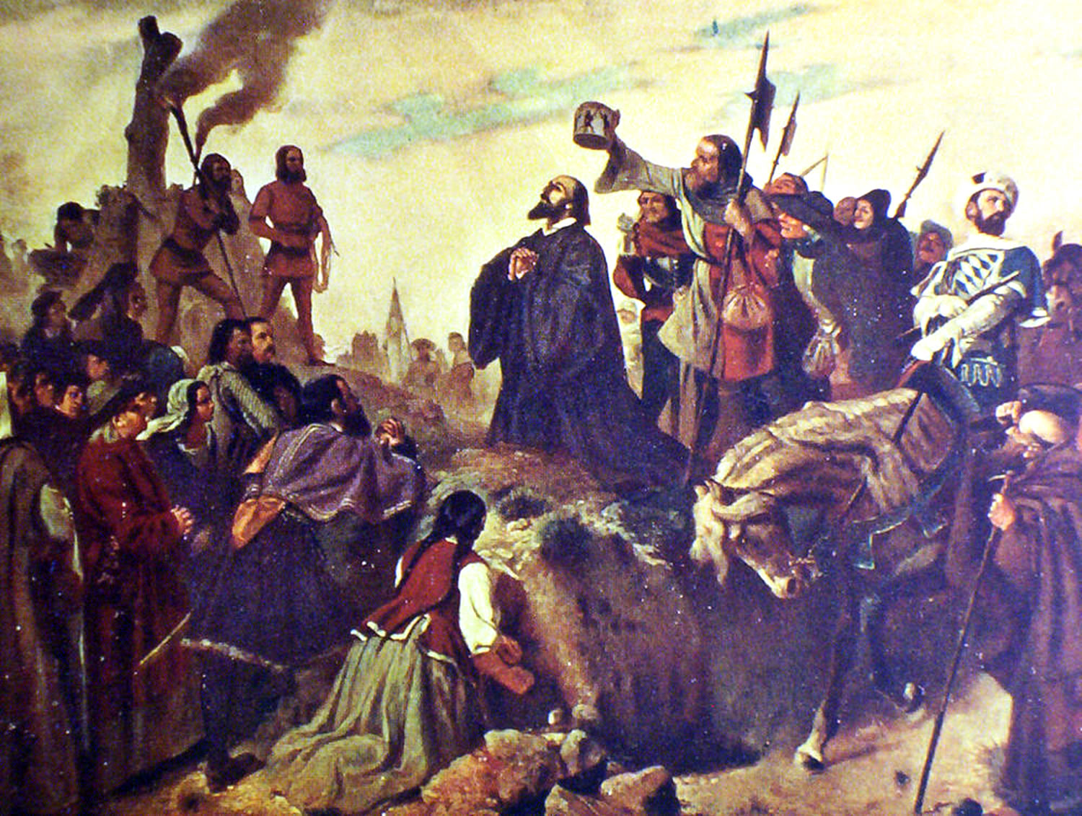
Now we will cook the goose (“hus”).
Yes, but there will come an eagle in a hundred years that you will not reach.
Saturday, 6 June 1415, the day celebrated by Jews as Passover.

Slide 17
What were Jan Hus’ crimes?
“As for antichrist occupying the papal chair, it is evident that a pope living contrary to Christ, like any other perverted person, is called, by common consent, antichrist.”
Jan Hus was a university teacher and rector and a priest, who criticized the Catholic Church for diverting from its original ideals, the priests’ immoral lifestyle and the trafficking in indulgences.
He also condoned a number of the beliefs held by John Wycliffe and the Lollards, such that the Bible should be preached and translated into the common languages.
He refused to recant, was accused of heresy and burnt at the stake by decision of the Council of Constance on July 6, 1415, despite his Safe-conduct from the Emperor of the Holy Roman Empire, Sigismund.
Priests told Sigismund that oaths made to heretics were not binding.

Slide 19
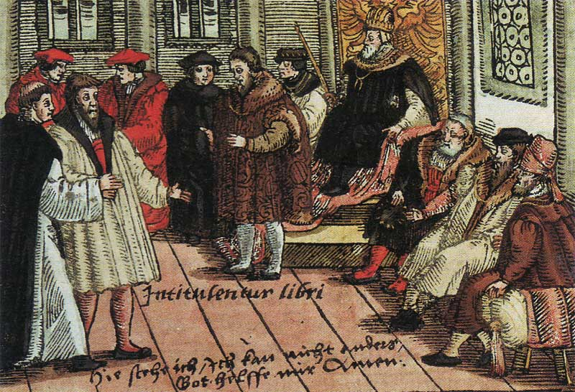
The Hussite Wars, 1419-1436
Knights and nobles of Bohemia and Moravia protested against Hus’ murder, incensing the head of the Holy Roman Empire, who threatened to drown all Wycliffites and Hussites.
The majority of the Czech population of Bohemia became Hussites.
The Hussites formed a major spontaneous military power. The incensed people rebelled and prepared for war, driving many Catholic priests from their parishes during the years from 1415 to 1419.
Notes:
Reforms included bibles in the “vulgar” languages for all to read and communion in both kinds, bread and wine. The major error pointed out was the pope as God’s representative on earth. Later wrote the church was founded on Christ, not on Peter. Excommunicated in 1412.

Slide 20
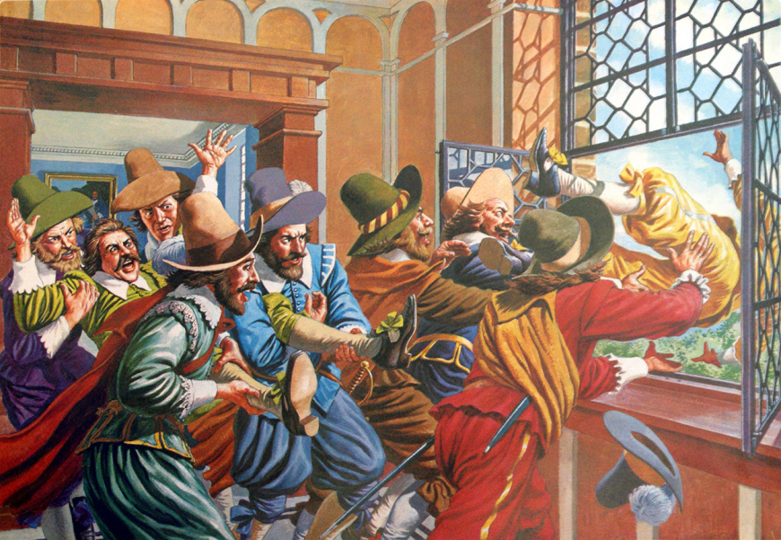
The Hussite Wars, 1419-1436
30 July 1419, Hussites attacked New Town Hall, Prague, and threw the king’s representative, burgomaster and councillors from the windows into the street, several being killed.
Bohemian King Wenceslaus IV died two weeks later.
Troubles spread.
Fighting to control Prague destroyed much of the city before a truce on 13 Nov. The truce returned the captured castle to the Royalists and Jan Žižka, who had captured it, left Prague.
To counter the might of mounted armored knights, Jan Žižka came up with the innovation of the battle wagon and wagenburg tactics. Their many victories also allowed the Hussites to regularly upgrade their weapons and armor.
Notes:
Reformed included bibles in the “vulgar” languages for all to read and communion in both kinds, bread and wine.

Slide 21
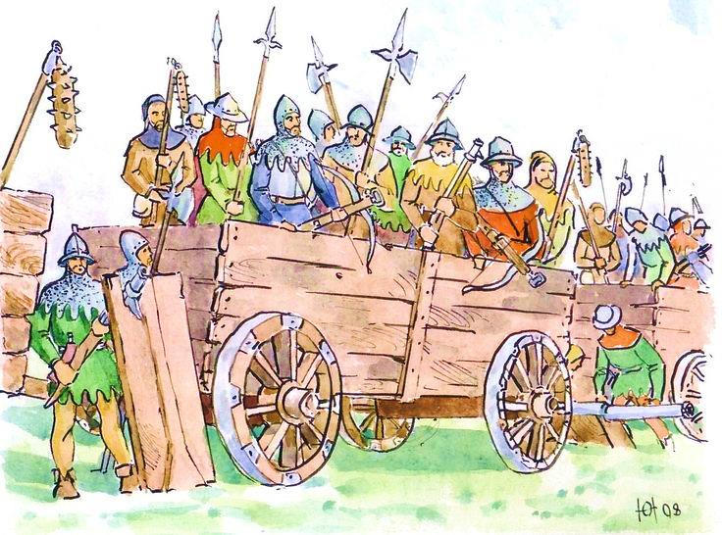
Hussite Tanks - the battle wagon
Wagons were modified for use as mobile fortifications.
Battle wagons would be formed in circles or squares and chained together to form defensive laagers (aka tabors).
Typical Crew
4-8 crossbowmen
2 handgunners
6-8 soldiers with pikes or flails
2 shield carriers
2 drivers
18 to 21 soldiers
-++=

Slide 22
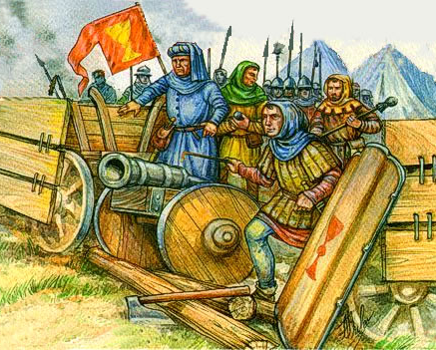
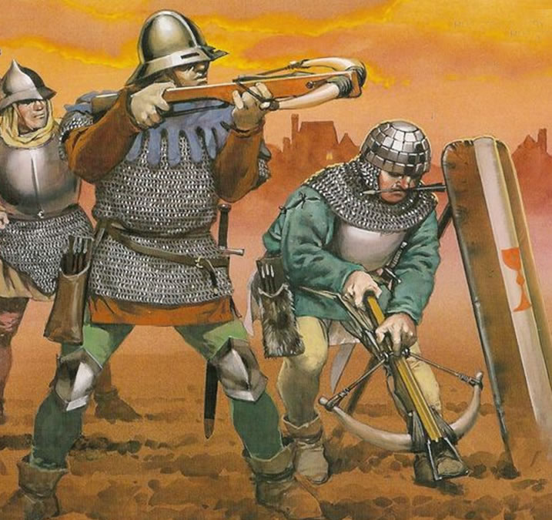
Hussite Artillery – guns and ranged weapons
First European army with massive use of gunpowder.
Hussite crossbows were also effective short range killers.
Hussites used weapons ranging from howitzers (houfnice = group) to hand guns (píšťala = pipe).

Slide 23
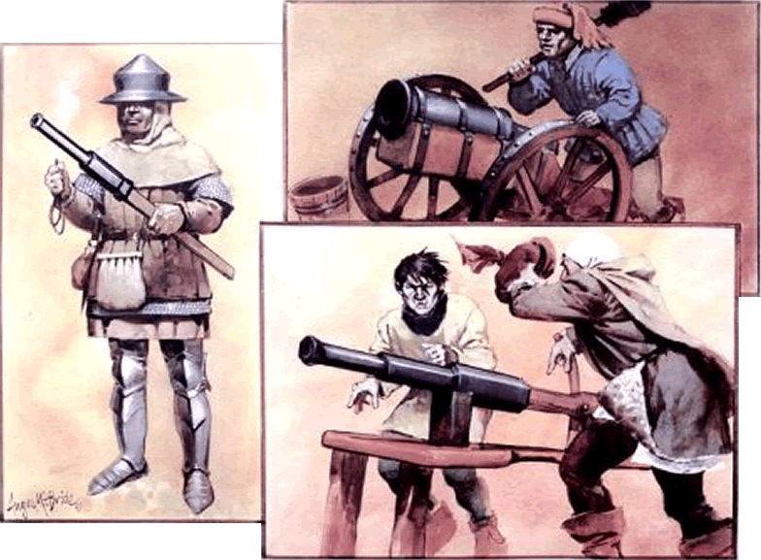
Hussite Artillery – guns and ranged weapons
Houfnice: range to 250 meters.
Píšťala: .50-.80 calibre; short range; shock effect.
Range 250-
300
meters;
aimed
Tarasnice: 2”-4” bore

Slide 24
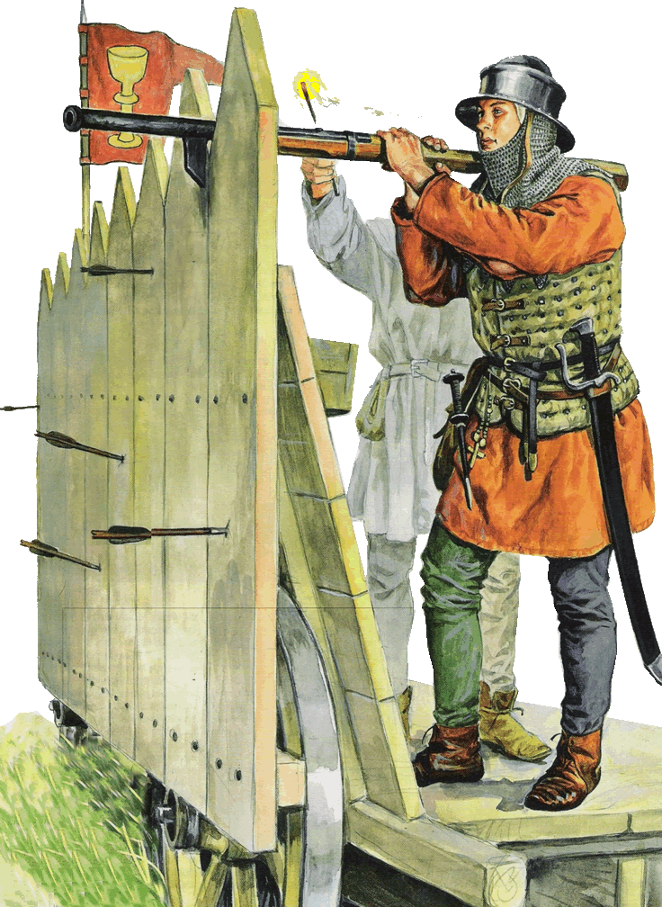
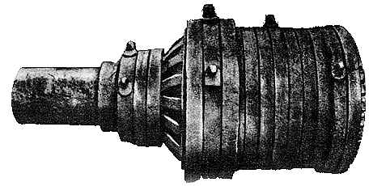
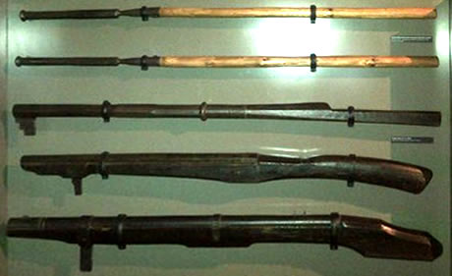
Hussite Artillery – guns and ranged weapons
Bombarda (heavy mortar) siege weapon up to 34” bore; range to 500 meters.
Píšťala
Hákovnice ( Hook gun): 50-100mm bore; 2.00-4.00 calibre; range to 100 meters; hook is recoil device.
Hákovnice

Slide 25
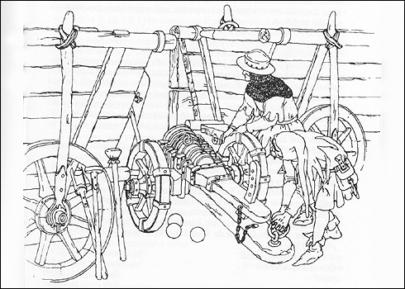
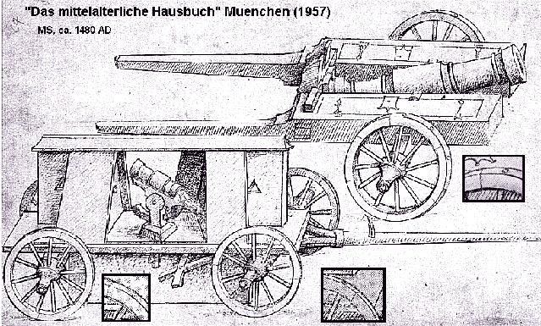
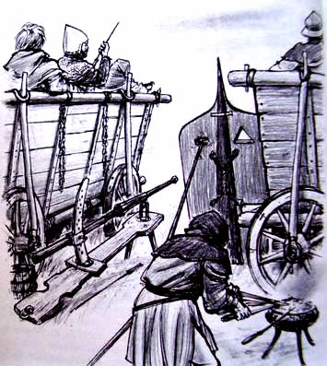
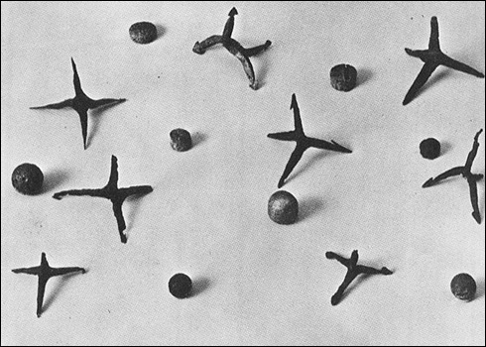
Hussite Artillery – howitzers
Transportable/mobile.
Easy set up and use
Deadly
Steel balls
Lead shot
Rocks, stone
Canister
Flechettes
Whatever

Slide 26
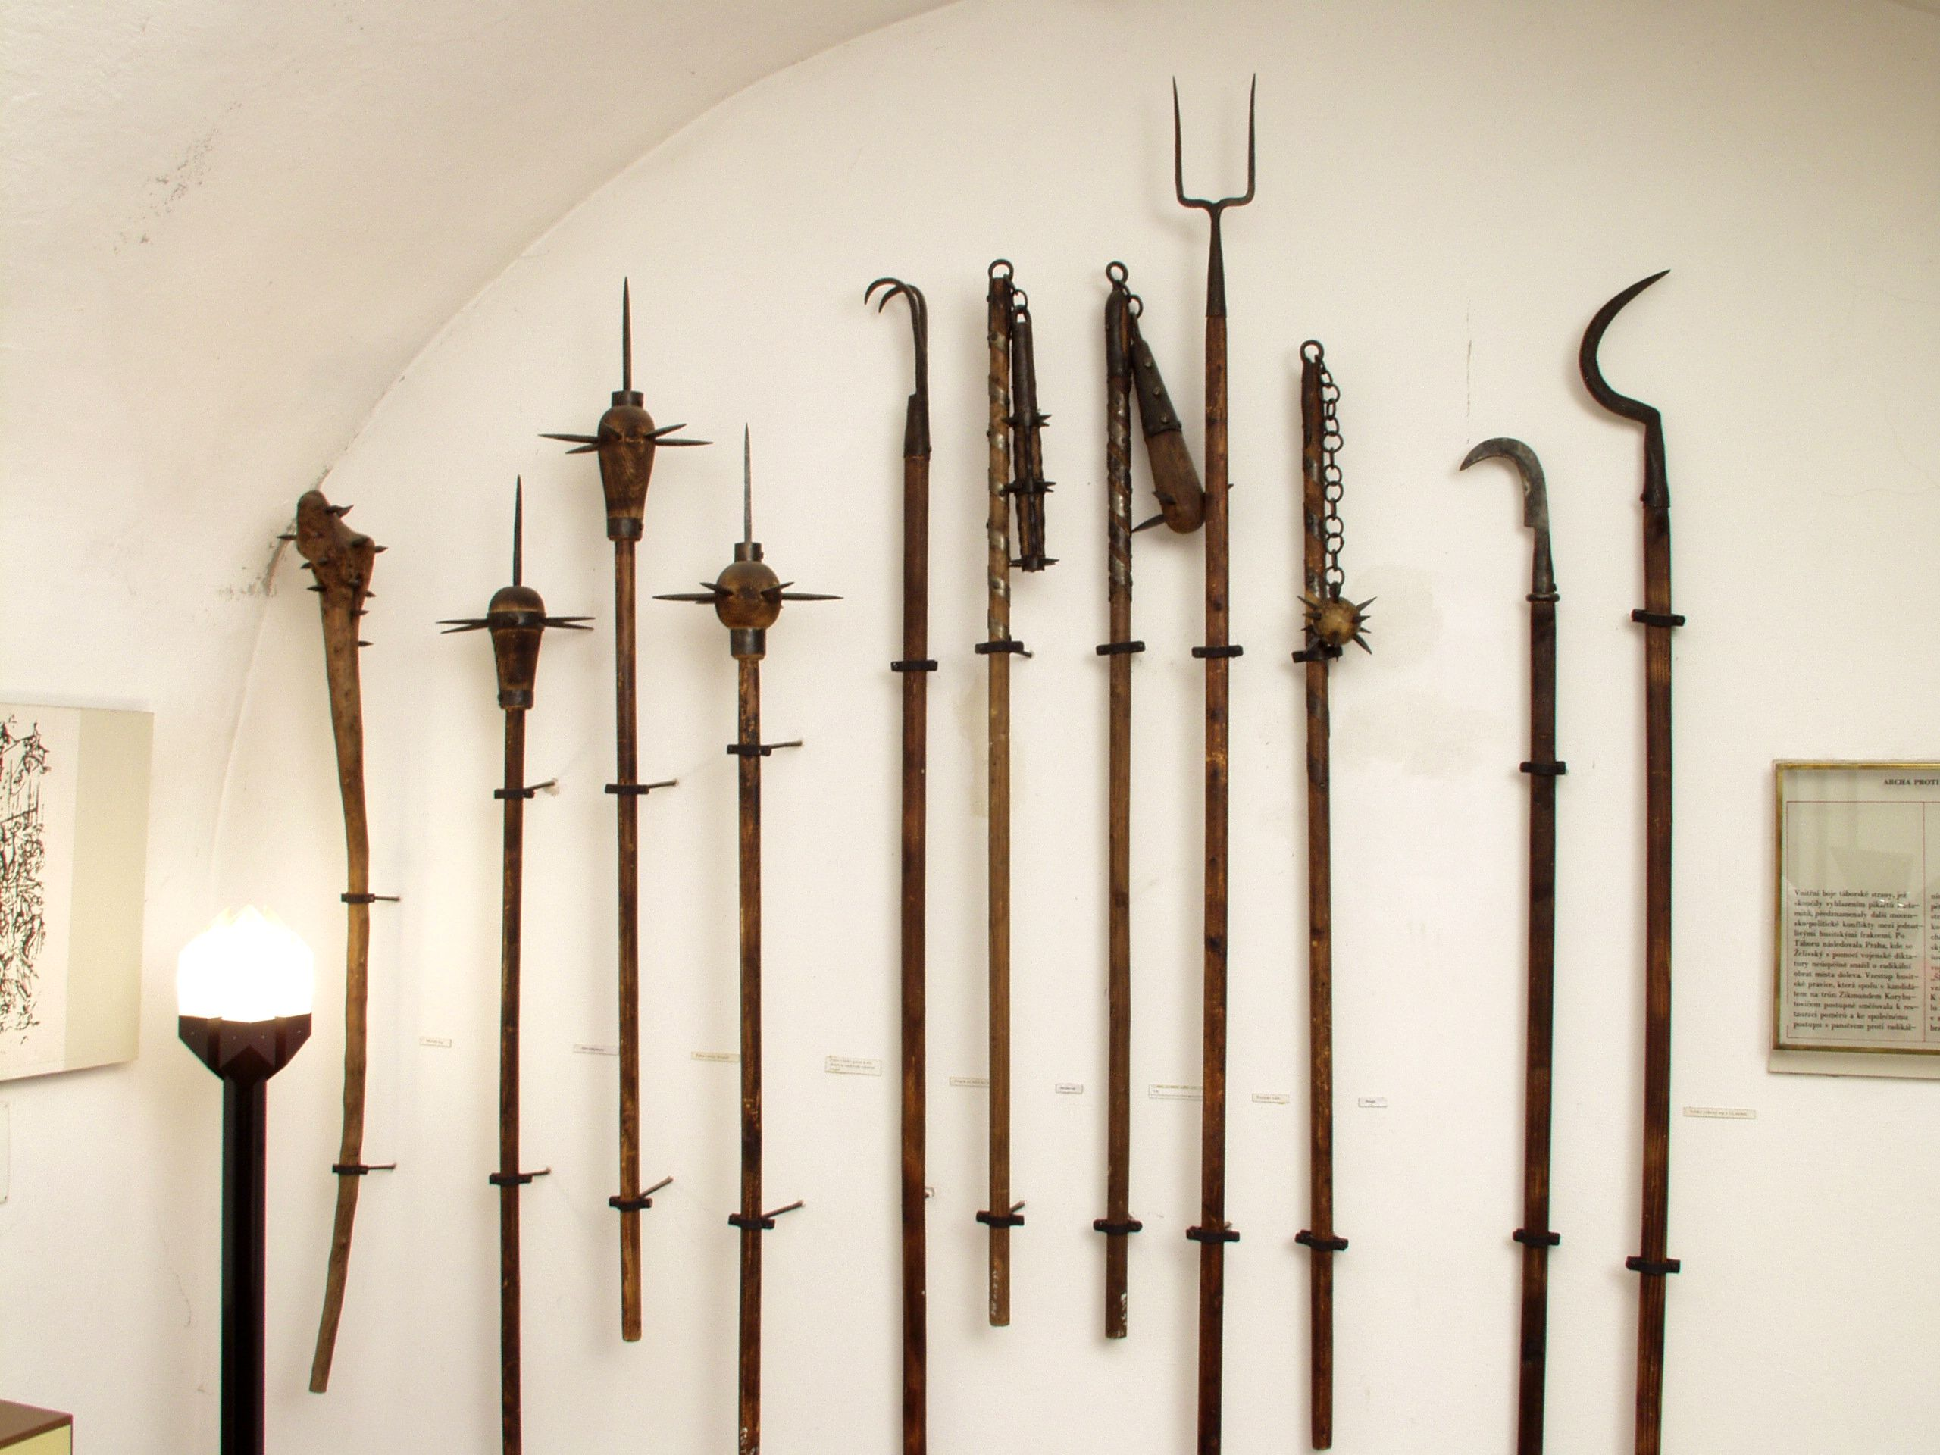
Hussite Infantry weapons
Modified farm implements, flails, anything deadly.
Swords, knives, axes, spears, hammers, picks, stakes, etc.

Slide 27
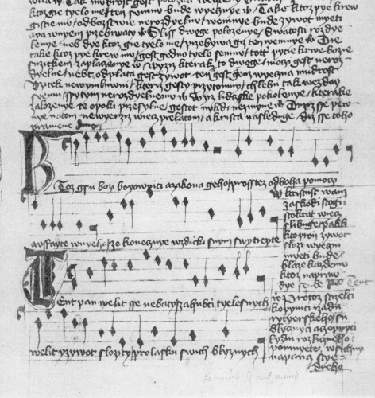
Hussite weapons - music
Ktož jsú boží bojovníci
1. Czech first line of self-titled hymn, which means: “Ye who are warriors of God”

Slide 28
Hussite weapons - music
Ktož jsú boží bojovníci
Source: Choral of the Hussites, Prague, singing Ye who are Warriors of God (Youtube).

Slide 29
Hussite weapons - music
Ktož jsú boží bojovníci
The song was sung with such intensity during the Hussite Wars, that it instilled fear throughout the enemy army, making it a weapon in itself. One of the Imperial Crusades is believed to have fled the battlefield before the battle itself, just by hearing the Hussites singing proudly their hymn.¹
Ktož jsú boží bojovníci
1. John William Mears. "Heroes of Bohemia: Huss, Jerome and Zisca." (1879)

Slide 30
Ktož jsú boží bojovníci
Ye who are God's warriors and of his law,
Pray to God for help and have faith in Him;
That always with Him you will be victorious.
Christ is worth all your sacrifices, He will pay you back an hundredfold.
If you give up your life for Him you will receive eternal life.
Happy is he who dies fighting for the truth.
The Lord commandeth you not to fear those who harm the body,
And commandeth you to even put your life down for the love of your brothers.
Therefore, archers, crossbowmen, halberdiers of knightly rank,
Scythemen and macebearers from all walks of life,
Remember always the Lord benevolent.
Do not fear your enemies, nor gaze upon their number,
Keep the Lord in your hearts; for Him fight on,
And before enemies you need not flee.
Since ages past Czechs have said and had proverbs which state,
That if the leader is good, so too is the journey.
Remember all of you the password which was given out.
Obey your captains and guard one another.
Stay sharp and everyone keep formation.
You beggars and wrongdoers, remember your soul!
For greed and theft don't lose your life.
And pay no heed to the spoils of war.
And with this happily cry out – saying, "At thee! Have at thee!“
Grasp the weapon in your hands and shout, "God is our Lord!"

Slide 31
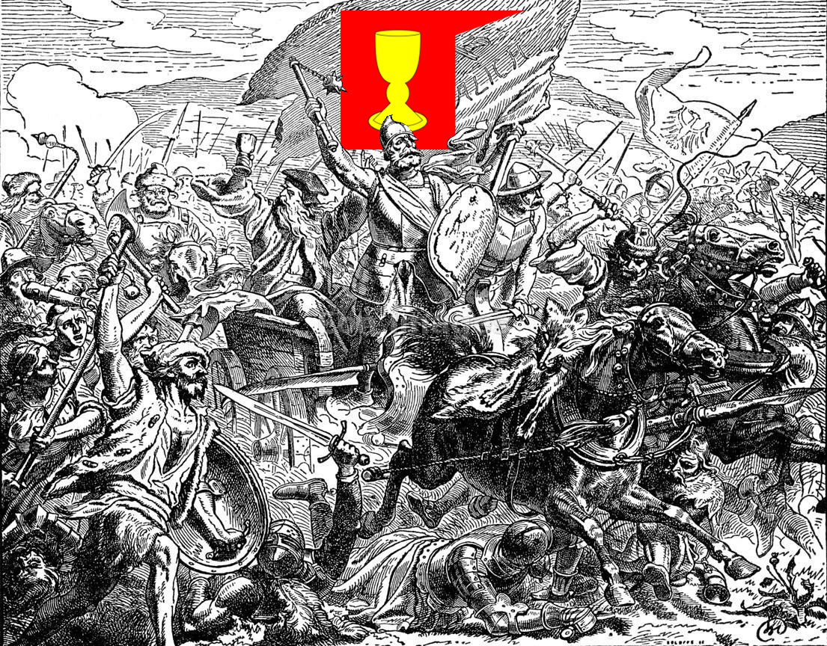
KEEP CALM
AND
FIGHT TO
THE DEATH

Slide 32
LIMITED WAR
WAS NOT IN THE
HUSSITE VOCABULARY

Slide 33
Battle wagon (wagenburg) tactics
Preparation: place wagons in formation on defensible terrain and chain them together as a fortress. Build ditch or stakes.
PHASE 1: DEFENSE
Man wagons, cavalry inside the square.
Pound the enemy with artillery using houfnice (howitzers) and píšťala (hand cannon).
Use crossbows within range.
Stones were available when ammunition was exhausted.
PHASE 2: ASSAULT
Infantry with swords, flails, and polearms would leave fortress to attack the weary enemy.
Cavalry in the square would also come out and attack.

Slide 34
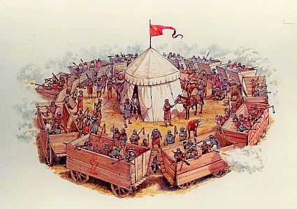
PHASE 1 - DEFENSE

Slide 35
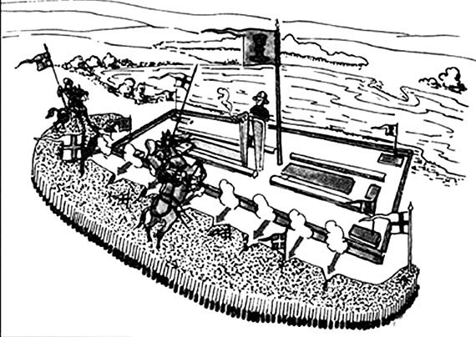
All-around 360° defense.
METT-TC Mission, Enemy, Terrain & Weather, Troops - Time, Civil (support, etc.).
Anchor on defensible terrain.
Carefully watch for breakthroughs.
Apply maximum force in defence.
Heavy use of long range artillery.
Force enemy to attack strength.

Slide 36
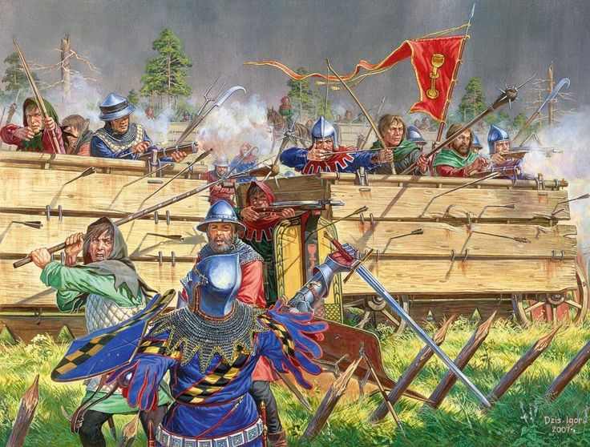
PHASE 2 - COUNTERATTACK

Slide 37
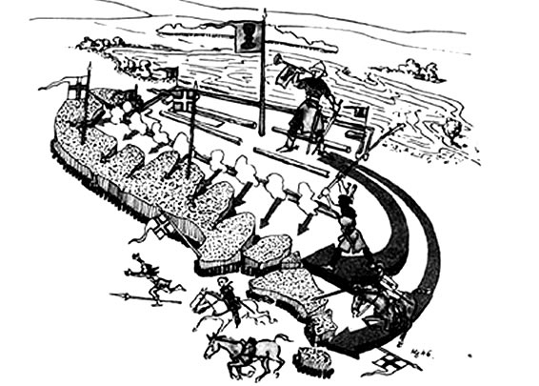
Breakthrough
Envelop
Identify enemy weaknesses.
Penetrate
Widen the gap
Exploit!

Slide 38
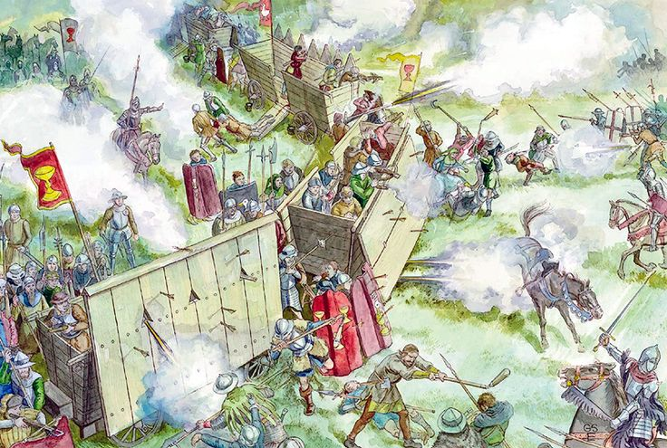
PHASE 2 – COUNTER-ATTACK

Slide 39
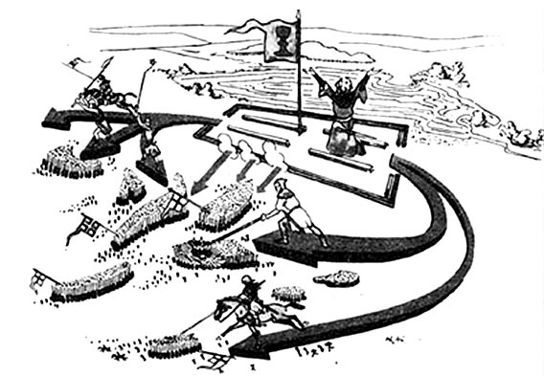
Double envelopment
Double envelopment
Double envelopment
Frontal assaults

Slide 40
KEEP CALM
AND
SHOW NO
MERCY

Slide 41
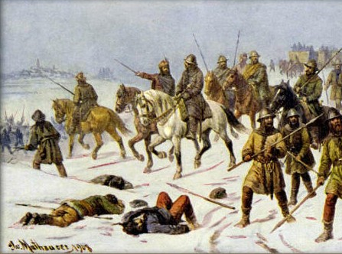
PHASE 3 – FINISH
"[H]aving reluctantly unsheathed the sword, the Hussites used it to such good purpose that their enemies long remembered the lesson that had been taught them.” JA Wylie

Slide 42
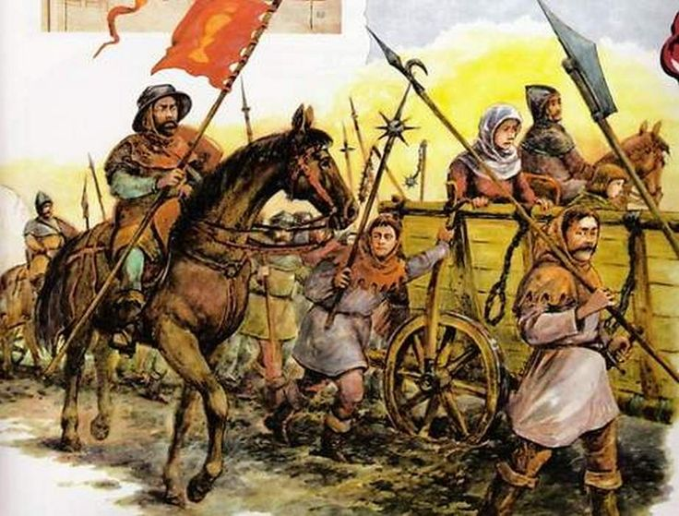
PHASE 4 – CONTINUE JOURNEY

Slide 43
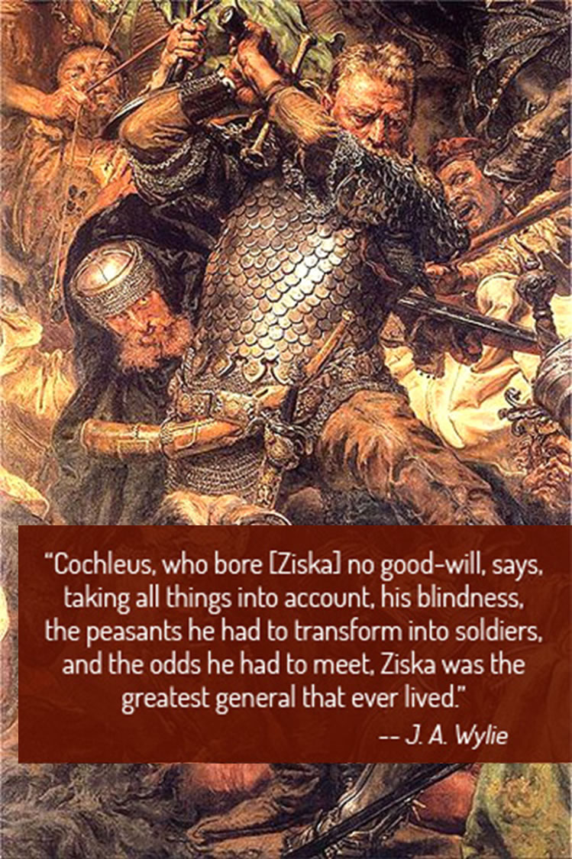
Hussite Hejtman (General) Jan Žižka
Born c. 1360 to aristocrats.
Chamberlain to Queen Sofia.
Fought at Battle of Grunwald on 15 July 1410 (1st Battle of Tannenberg) as a mercenary.
He invented tactics for mainly peasant armies to counter mounted knights. Deployed armored wagons offensively like tanks when in open or chained together in defense.
Died undefeated of plague in 1424 after victory at Malesov.

Slide 44
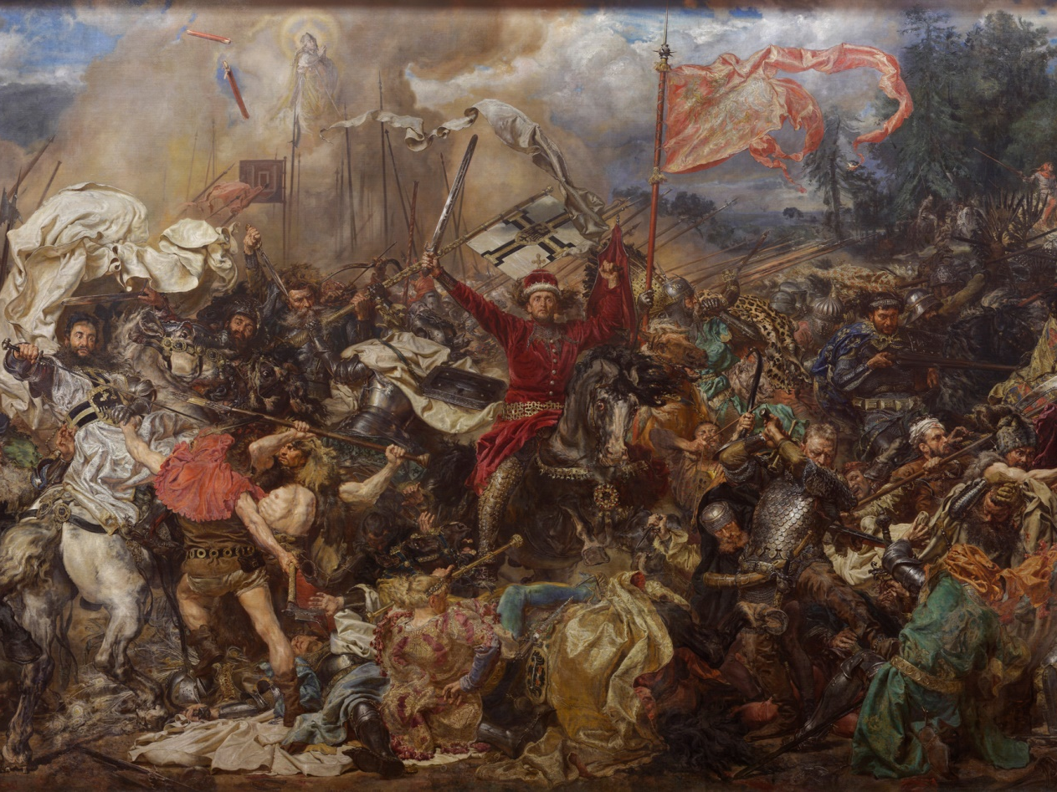
The 1st Battle of Tannenberg (Battle of Grunwald)

Slide 45
Lost left eye in childhood
Lost 2nd eye in 1421 sieging Rabi Castle.
Žižka fought under Czech general Sokol in 1410; took part in the defense of Radzyń.
Žižka summarily slayed every man, woman and child in Adamite communities, like Adamites did toward other villages. The Adamites were a threat mostly in the sense that their customs and theology were different.
Their many victories allowed the Hussite to regularly upgrade their weapons and armor.
Because he knew the Czech lands well, he could move his army anywhere within three days. There he unfailingly found the best location for defense.
Žižka is considered to be among the greatest military leaders and innovators of all time and is one of several commanders in history who never lost a battle

Slide 46
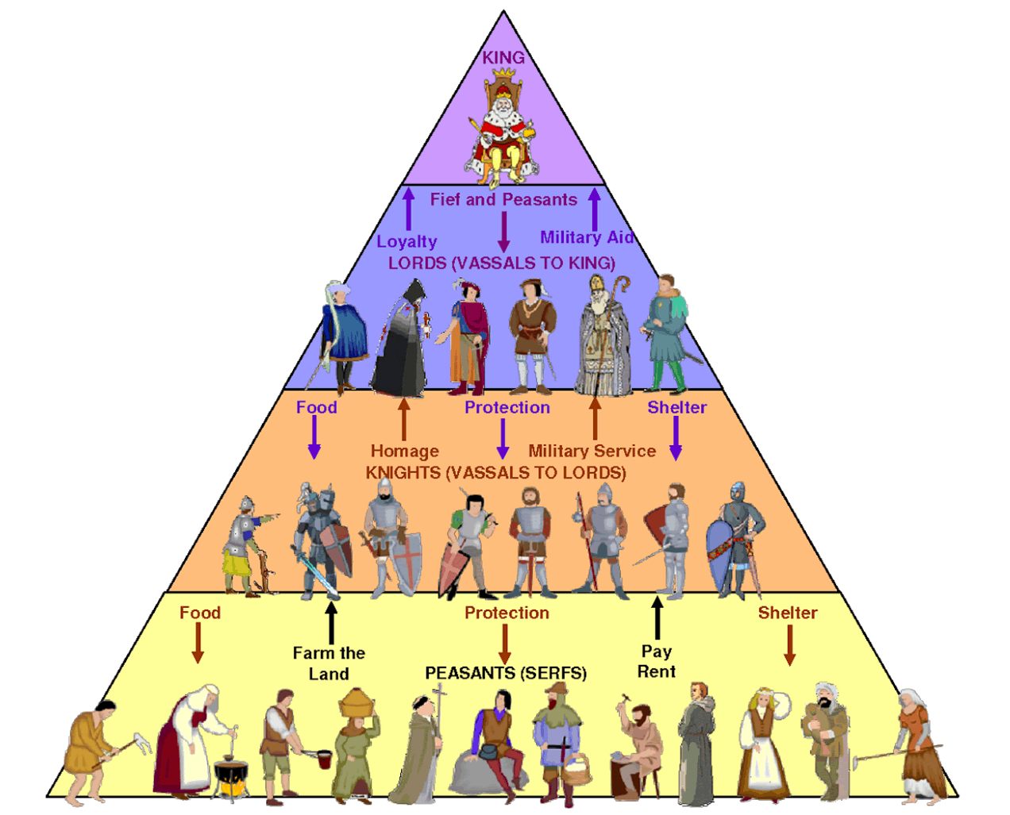
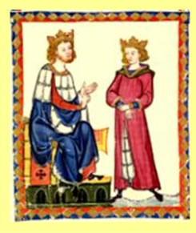
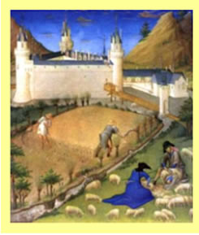
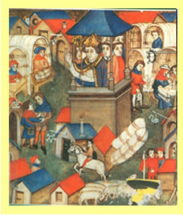
Decentralized, local government
Dependent upon relationships between members of the nobility
Lord and his vassals administered justice and were the highest authority in their land
Agriculture (land) the basis for wealth
Lands divided into self-sufficient manors
Peasants (serfs) worked the land and paid rent in exchange for protection
Barter the usual form of exchange
POLITICAL SYSTEM: FEUDALISM
ECONOMIC SYSTEM: MANORALISM
MEDIEVAL
LIFE
RELIGIOUS SYSTEM: CATHOLICISM

Slide 47
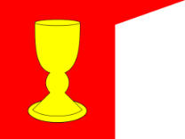
Hussites
Moderates willing to compromise with Roman Catholic church¹
Radicals
Unwilling to compromise² with Roman Catholic church
Praguer
primarily Bohemian nobility, students and merchants; moderates. Also called Calixtines (calix=chalice)
Utraquist
communion in both kinds; major moderate faction of Hussites (lasted until Thirty Year’s War, 1620)
Taborite
communal society funded by gold mines; strict Bible interpretation; major radical faction
Adamite
no transubstantiation, anti priesthood, anti Supper; said to favor free love; minor radical faction abhorred by all.
Žižka's “Orphans’ Union”; founded 1423 as Lesser Tabor when Taborites became too radical for Žižka; merged with Orebites 1423; radicals
Sirotci
Lesser Taborite
Split off from Taborites in 1423.
Orebite
Eastern Bohemians; radicals
Reform but leave liturgy and church hierarchy intact.
The Bible is the sole rule and canon for all things.

Slide 48
The Four Bohemian Articles
The free preaching of the Bible.
The right of the whole church to both the bread and the wine in the communion and the use of the mother tongue in divine worship.
The exclusion of the clergy from all secular offices and authority.
In cases of crime, the jurisdiction of the civil courts over clergy and laity alike.

Slide 50
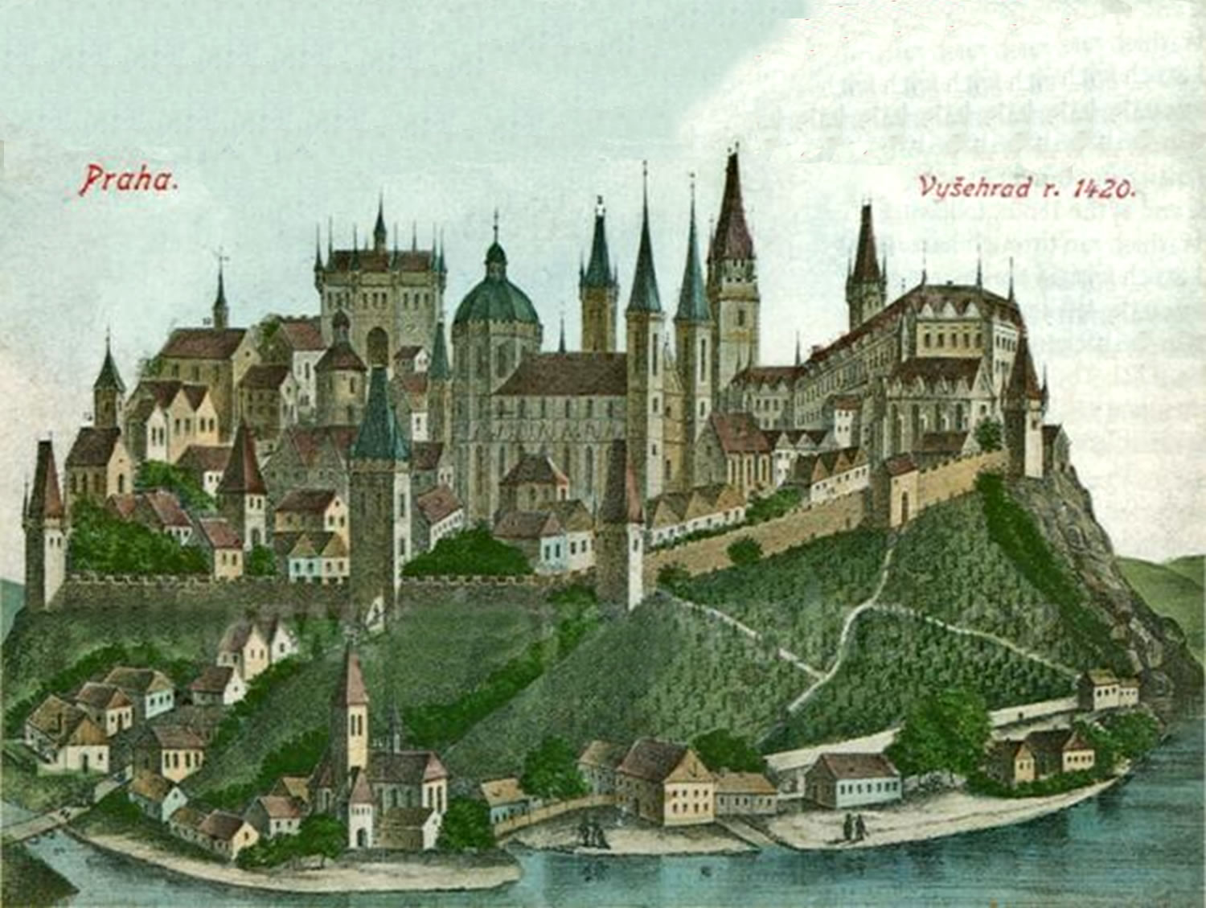
Prelude – The Battle of Vyšehrad Castle Captured by the Hussites 25 October 1419

Slide 51
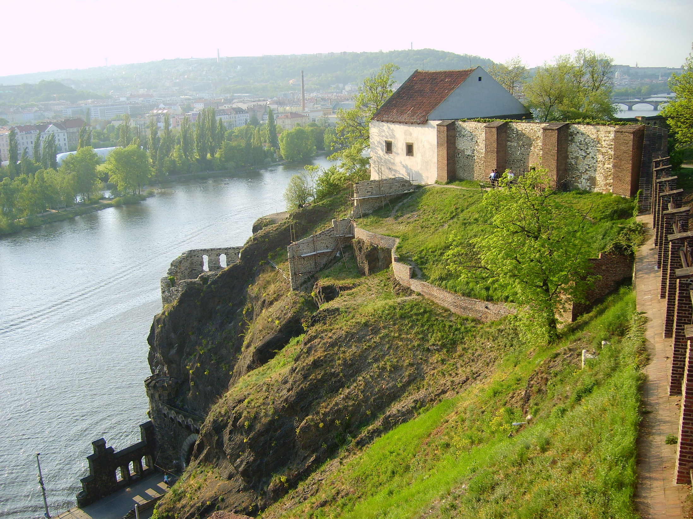
Vyšehrad – The Castle on the Heights

Slide 52
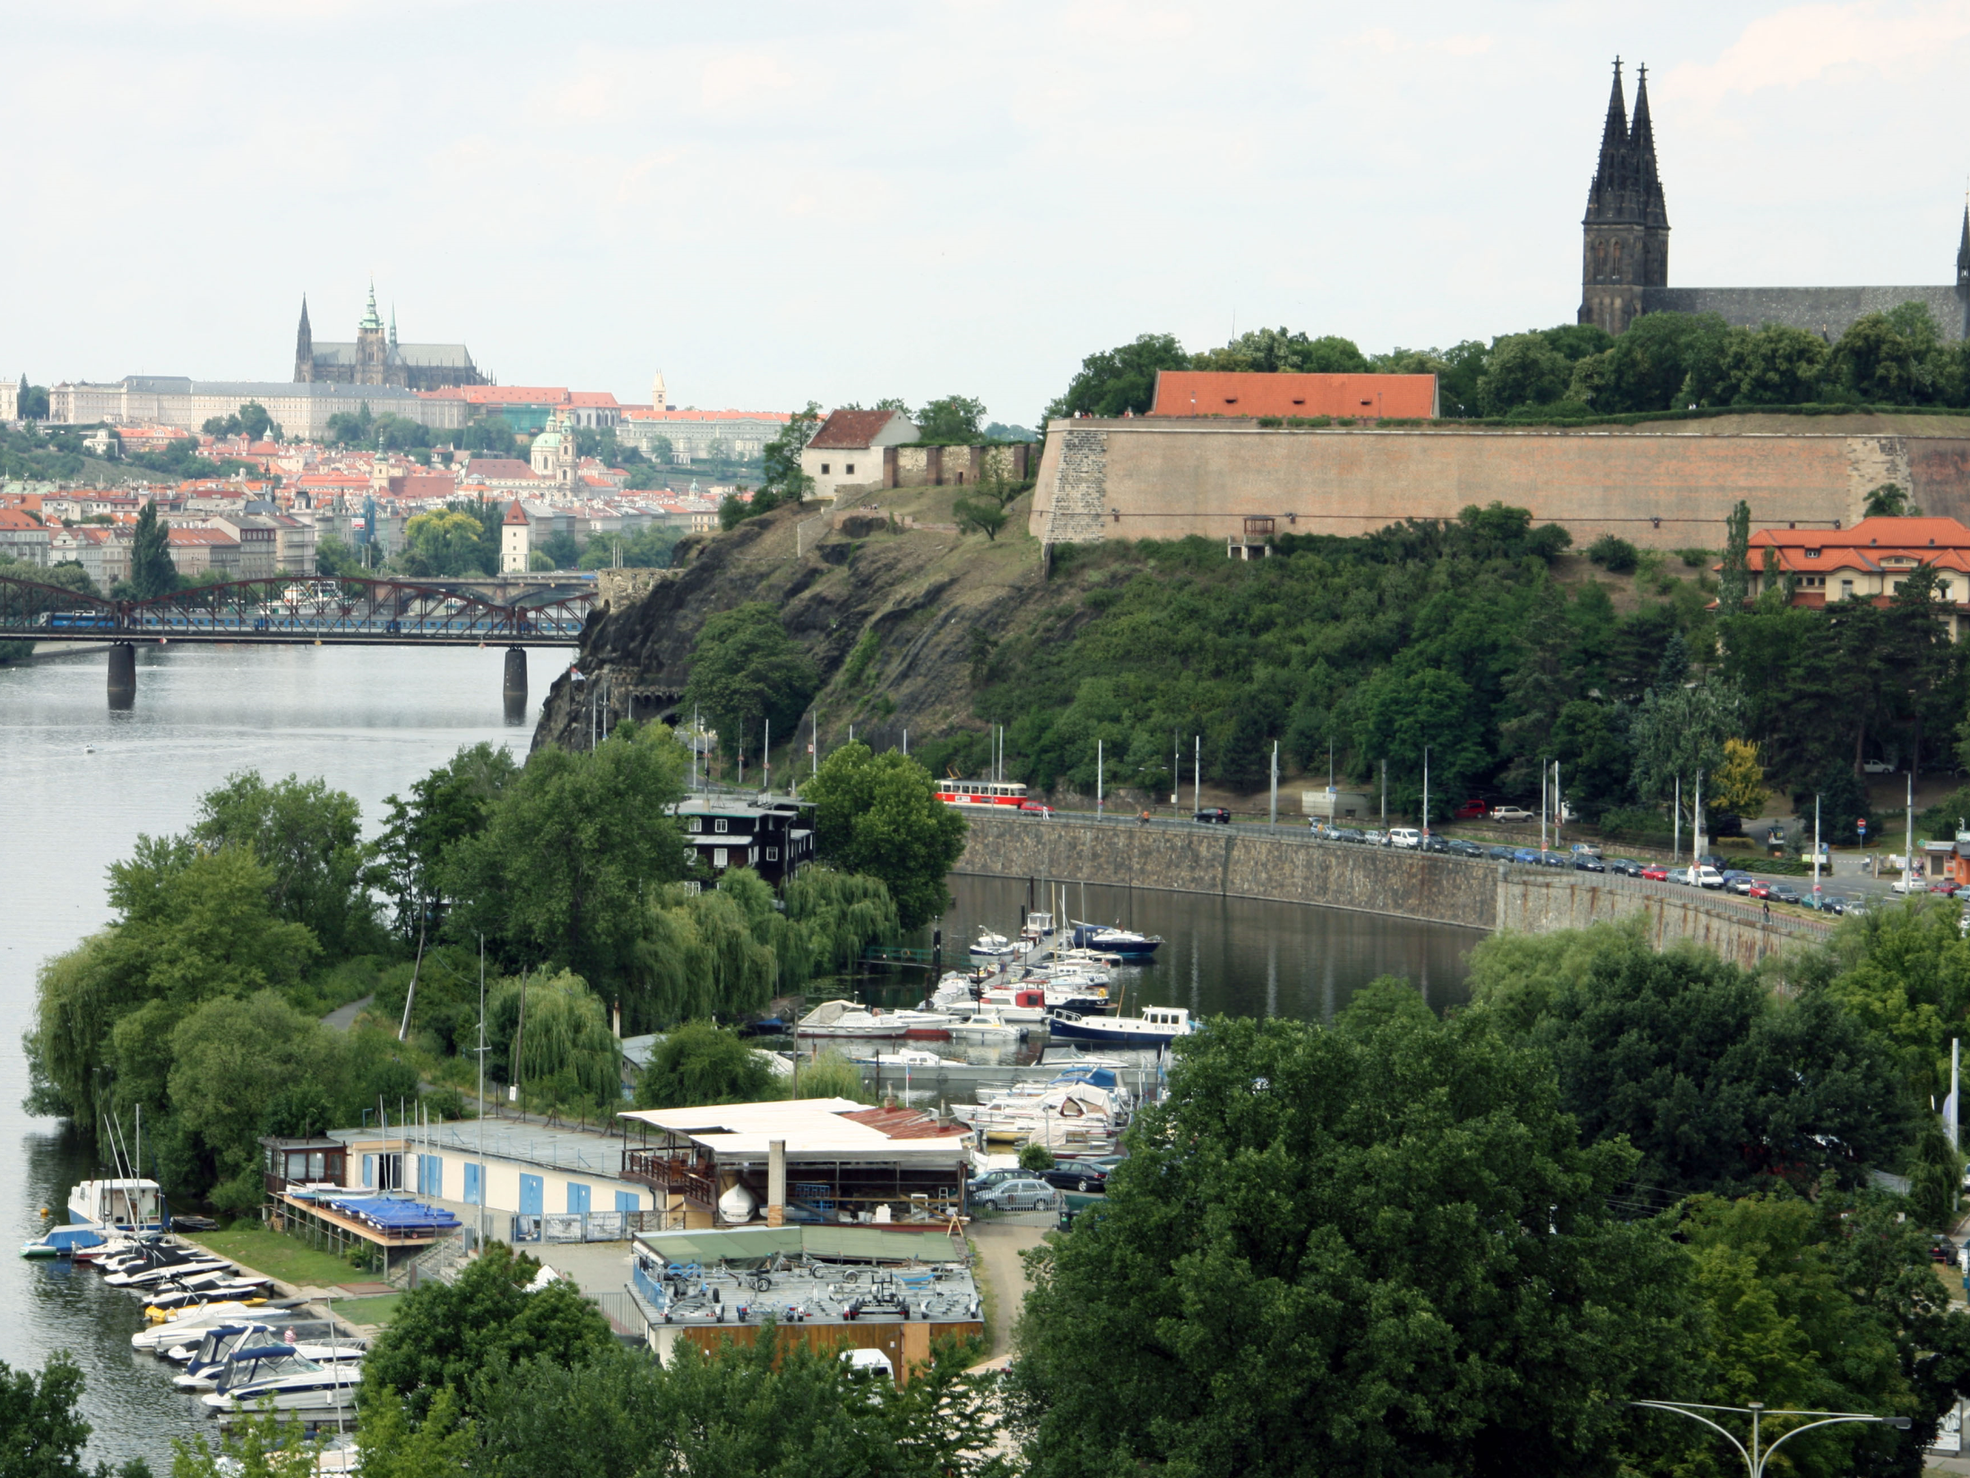
On 13 November 1419 Queen Sophia promised to protect the Hussites in all of Bohemia, and Vyšehrad was returned to the royal army. Dissatisfied with the decision, Jan Žižka led some 400 soldiers from Prague.

Slide 54
Prelude – The Battle of Nekmíř
A series of engagements took place at the start of the Hussite War between Hussite forces and Catholic crusaders sent by Emperor Sigismund. The battle took place at the castle of Vyšehrad from 16 August 1419 to c. 1 November 1420.
In December 1419, a formation besieging Nekmer castle near Plzeň (Pilsen) under the command of Jan Žižka was surprised by 2000 Royalist cavalry under the command of Bohuslav of Švamberk. A cavalry attack was stopped by crossbow and gunfire from Hussite soldiers hiding behind wagons. Catholic infantry and cavalry were forced to withdraw. After the battle Žižka ordered a night march to Plzeň.
Seven of Zizka's wagons mounted artillery pieces and were able to inflict heavy (and unexpected) casualties on the Royalist troops, allowing the Hussites to withdraw (gracefully) from the siege.

Slide 55
Battle of Nekmíř, December 1419
Belligerents
Hussites | Bohemian Catholics
Commanders and leaders
Jan Žižka | Bohuslav von Schwanberg
Strength
400 infantry 7 war wagons | 2,000 cavalry
Casualties and losses
Unknown | Heavy

Slide 57
Battle of Sudoměř, 25 March 1420
Belligerents
Hussites | Bohemian Catholics Order of Malta
Commanders and leaders
Břeněk of Švihov † Jan Žižka | Bohuslav von Schwanberg Henry of Hradec (DOW)
Strength
400 infantry 12 war wagons | 2,000 cavalry
Casualties and losses
Heavy 3 wagons destroyed 30 captured | Heavy (some sources say 2,000)

Slide 58
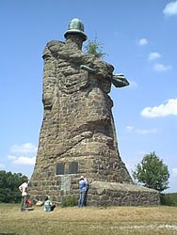
Stone block commemorative statute of Jan Zizka erected in 1920 at the Sudomer battlefield by sculptor Emanuel Kodet with the help of builder František Kulíře.

Slide 59
The Battle of Sudomĕř was fought on 25 March 1420, between Catholic and Hussite forces. The Hussites were led by Břeněk of Švihov - who was killed in battle - and Jan Žižka, whose forces proved victorious.
This was the second major battle of the Hussite Wars; the first battle, the Battle of Nekmíř, was more of a Hussite retreat than a true fight.
The Battle of Sudomĕř began after Hussite forces which had taken up temporary fortifications on the plains were found by Royalist forces, who closed in for an attack. The Hussites were greatly outnumbered 5 to 1, and initially hoisted the white flag, but when the Royalists refused to accept their surrender the battle truly began.
Though outnumbered and comparatively ill-equipped, facing heavily armoured knights, the Hussites had fortified their surroundings ingeniously. Their flank was protected by war wagons loaded with arquebusiers, and many large ponds and marshy areas surrounded the Hussite infantry - ground which the Royalist Cavalry could not hope to cross.

Slide 60
One thousand Johannites from Strakonice led by Jindřich of Hradec - killed in battle - attacked war wagons placed on a slim dam, with huge casualties but no success.
After that, another thousand Royalist cavalrymen, led by Peter von Konopischt of Sternberg - killed in the Battle of Vítkov Hill later that year - rushed a weakly held side of the Hussite formation, but were mired in marshy ground. They dismounted in order to progress, but soon found themselves mired once more. Following this, the Hussite light infantry equipped with flails were able to easily finish the cavalrymen.
The battle ended with the advance of night and fog, during which Žižka and the Hussite forces were able to escape. Though the Catholic Royalists were not entirely defeated, the fact the Hussites were able to inflict such heavy casualties with so few men, and then escape soundly proved to be a great victory. Only 400 Hussites - farmers and townsmen, including women and children - beat the 2,000-strong force of heavily armoured cavalry. Hussite General, Jan Žižka, through superior knowledge of tactics and terrain, along with the highly effective deployment of vozová hradba (wagon fort) strategies, won the day.

Slide 61
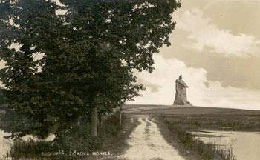
Part of the classic 1955 film “Jan Žižka” by director Otakar Vávra was filmed on location.

Slide 62
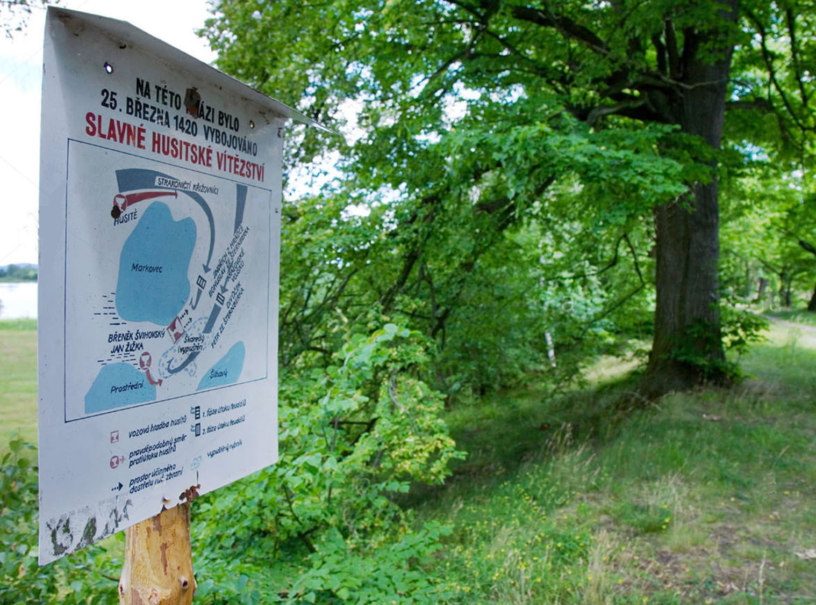

Slide 63
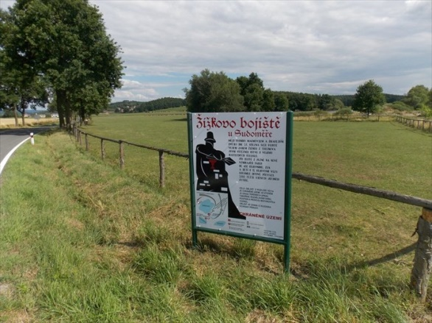

Slide 64
https://www.youtube.com/watch?v=wJB3E8Qbjyg

Slide 67
Feudal lords

Slide 76
In January of 1421, Jan Zizka started new operations in the Pilsen area, long strong supporters of the Royalist cause.
He surprised his enemies, both by attacking in the winter, and by approaching via a circuitous route. Fortified monasteries, villages, and castles fell to the Hussites in rapid succession.
Upon learning that Bohuslav of Svamberg, a leading Royalist noble and skilled commander, had retired to his castle, Zizka and his men changed their plans an besieged his stronghold. When it became clear that he couldn't hold out for long, Bohuslav negotiated a surrender.
The terms granted by Zisza, who respected Bohuslav, were quite generous, with Bohuslav being held under house arrest. This caused some grumbling among his taborite troops, but they removed one of Sigismund's key supporters. as the year progressed, Zizka began paying Bohuslav regular visits, and by October he had converted him to the Hussite cause, and he was released and fought on their behalf.

Slide 77
The Battle of Rábí Castle 25 October 1421

Slide 78
Rabi Castle
Rábí Castle dates from before 1380. It was established to protect trade routes along the Otava and also to inspect gold-bearing deposits in it. A strong palace, ramparts and a keep was later reinforced with an outer ward and two square towers.
At the start of the Hussite rebellions, the Švihovský family established a haven for supporters of the Catholic side in the district and for their treasures, at Rábí. In 1420–21, the Hussites conquered the castle twice.
Legend has it that during the second siege an arrow fired from crossbow hit the trunk of a pear tree and a resulting splinter from the tree hit Jan Žižka in his only good eye.
Rabí Castle was built in the form of three separate sections, constructed in tiers above each other. The ramparts were up to 6 metres (20 ft) wide, and had bastions, vallum fortifications and moats. However, building activity exhausted the Švihovský family's finances and the fortifications remained incomplete.
Provincial governor Půta Švihovský became the owner in 1479. An interesting fellow, Půta was into alchemy; a German alchemist who failed to transform lead into gold was imprisoned in the castle's massive prismatic tower. Půta had three nannies walled-in alive for turning his wife against his brothers.

Slide 79
Hussite leader Jan Zizka 1360-1424 dying from the plague at Pribyslav on October 11, 1424.

Slide 80
IN PRODUCTION
Warrior of God (Jan Žižka)
Go back to the period that preceded the outburst of Hussite fanaticism in a film about the power of passion, revenge and the meaning of the struggle for justice. A film from the dawn of the undefeated Czech leader Jan Žižka of Trocnov.

